Slide 1
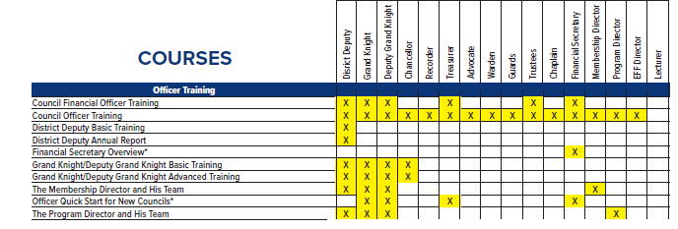
Suggested Training by Office

Slide 2
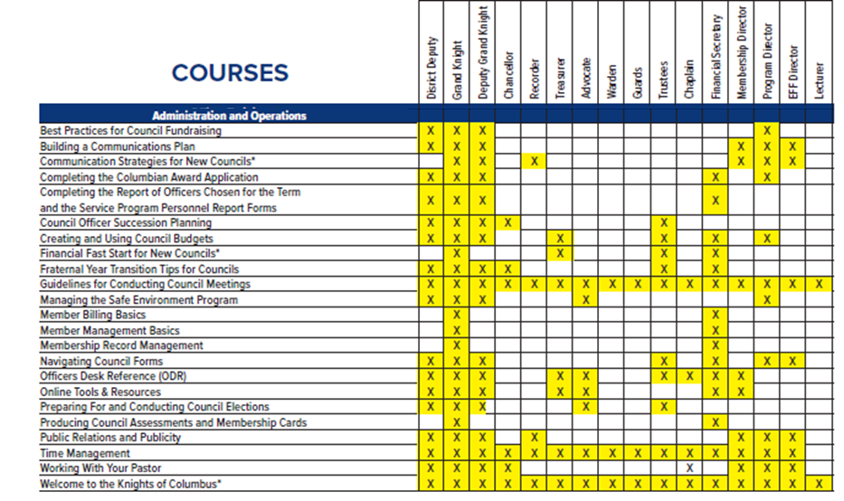
Suggested Training by Office

Slide 3
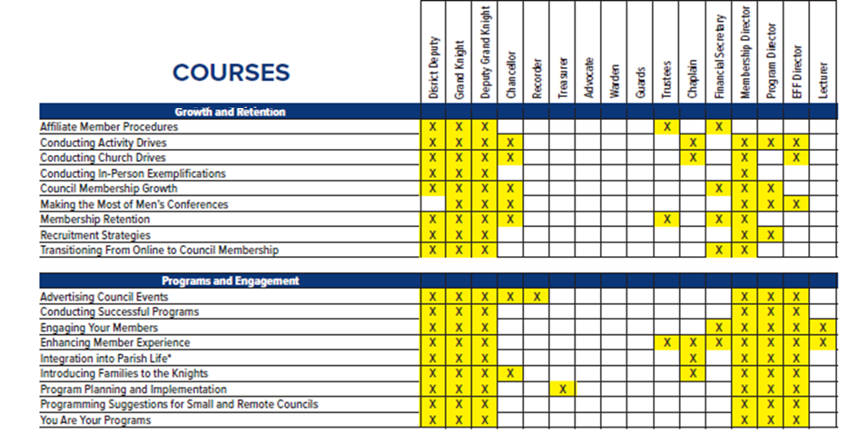
Suggested Training by Office

