Slide 1
Public Relations & Publicity
Jeff Maynard
Public Relations Director

Slide 2

Blow Your Own Horn

Slide 3
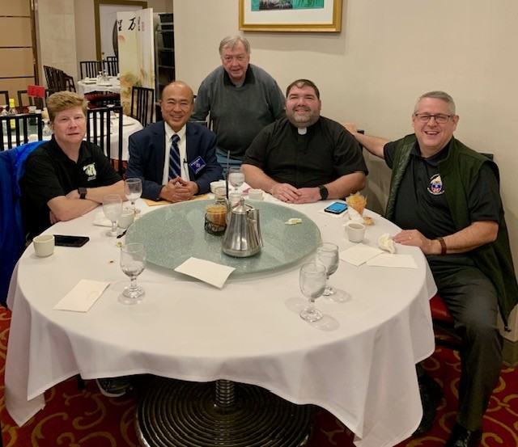
Resources
Parish Bulletin.
Newspaper
State Newsletter
Social Media
  The five “W’s”
    Who
    What
    Where
    When
    Why

Slide 4
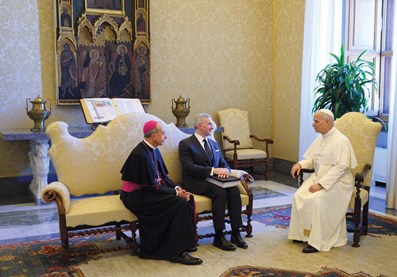
Columbia Magazine
knightsinaction@kofc.org

Slide 5
Social Media
When posting pictures of your events, try to include KofC branding.
If you have pictures of children, make sure that you have permission from their parent/guardian.
You should follow the MD State Council and you can follow other councils, too.
You do NOT have to accept friend requests from everyone who asks.
Limit the number of people who can post to the site.

Slide 6
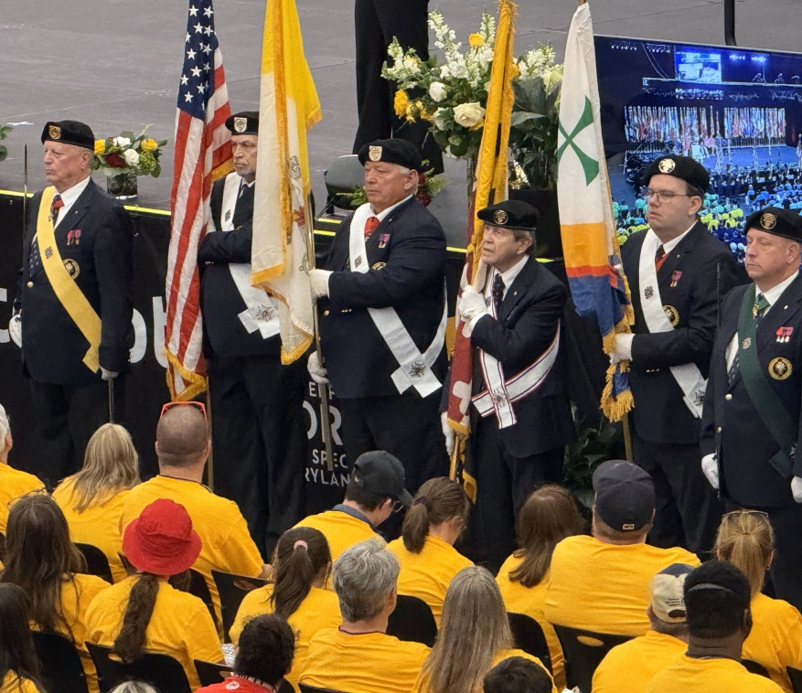
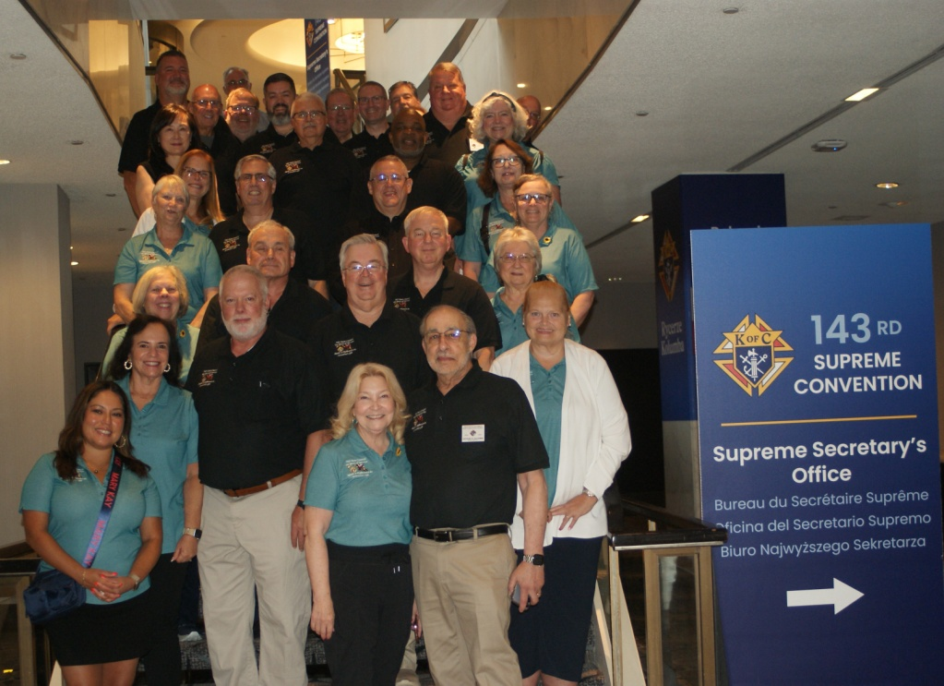
Brand Recognition

Slide 7
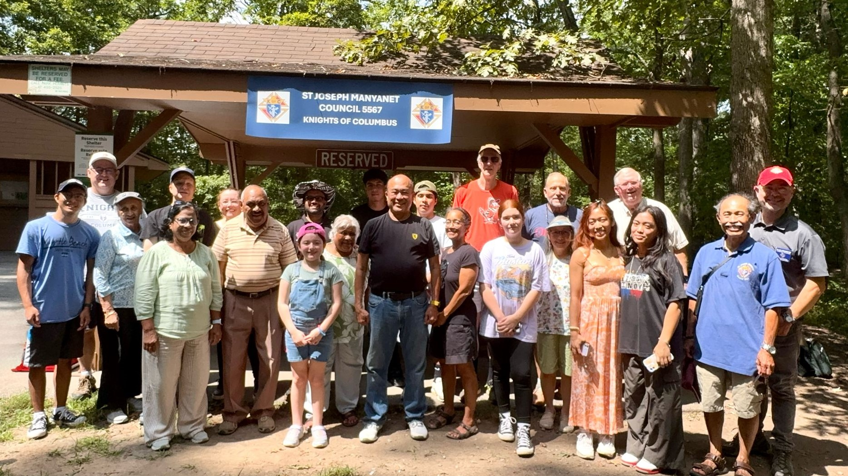
Brand Recognition

Slide 8
Final Thoughts
Make sure you use the official Knights of Columbus logos (intellectual property) correctly.
Be positive. Help shape public opinion for the KofC. Reflect Catholic values.
Do NOT engage in political discussions.

