Slide 1
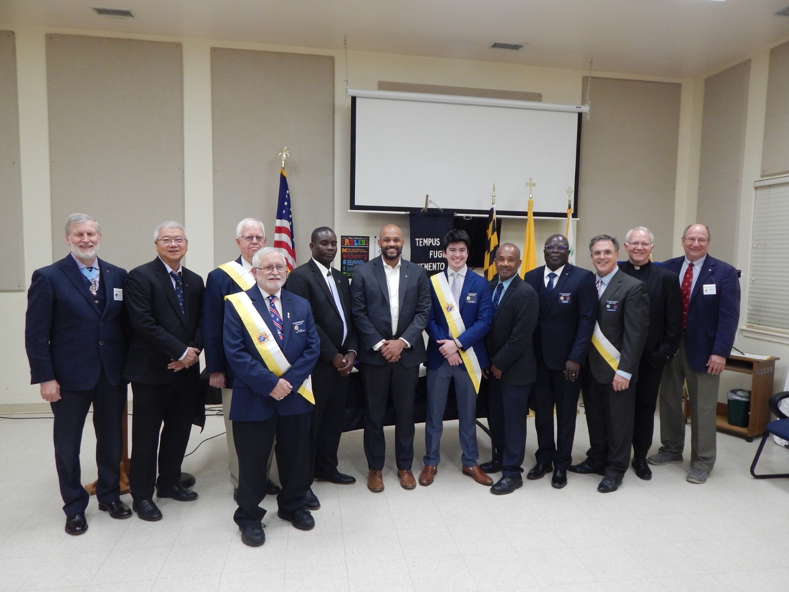

Membership Growth
Mid-Term Meeting 2026

Slide 2

Membership Growth Highlights
517 Catholic men welcomed into the Order!
90% of new members entered via OLM
81% of MD councils are membership-active

Slide 3
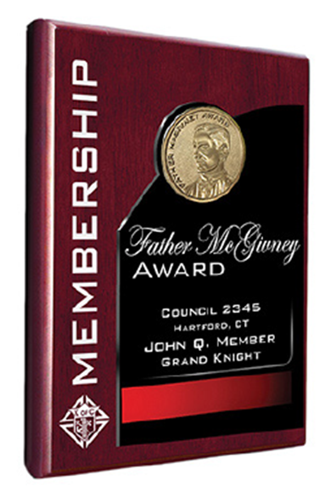
Membership Growth Highlights
24 councils and 5 Districts have earned the McGivney Award
17 District Deputies with 100% membership-active councils
Fast Start Incentive earned 10 councils over $7,500

Slide 4
Membership Growth Opportunities
1,121,031
Catholics in MD

Slide 5
Membership Growth Opportunities
413,454
Catholic Men 18+ in Maryland

Slide 6
Membership Growth Opportunities
27,177
Knights in Maryland

Slide 7
Membership Growth Opportunities
386,277
Catholic Men Not Knights

Slide 8
Membership Growth Opportunities
89,578
Catholic Hispanic Men in Maryland

Slide 9

Membership Growth Opportunities
Shrove Tuesday- Feb 17
Ash Wednesday- Feb 18: Lenten fish dinners
Basketball Free Throw events
Catholic Men’s Conference- Mar 14
O.C.I.A. Graduations- Easter, Apr 5

Slide 10
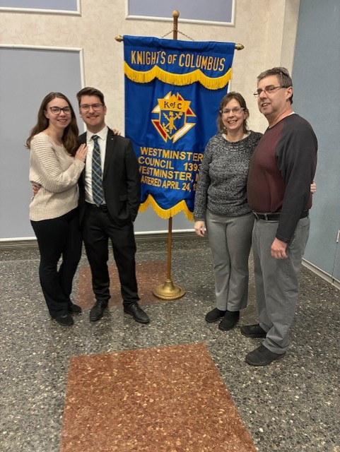
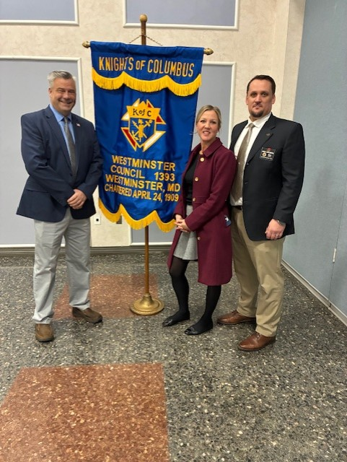
O.C.I.A. Opportunity

Slide 11
Membership Growth Opportunities
Cor participants
RSVP-seminarians, TMIY, parish groups
Spanish mass recruitment focus
Field Agent engagement
****Also- Are you using a council tri-fold?

Slide 12

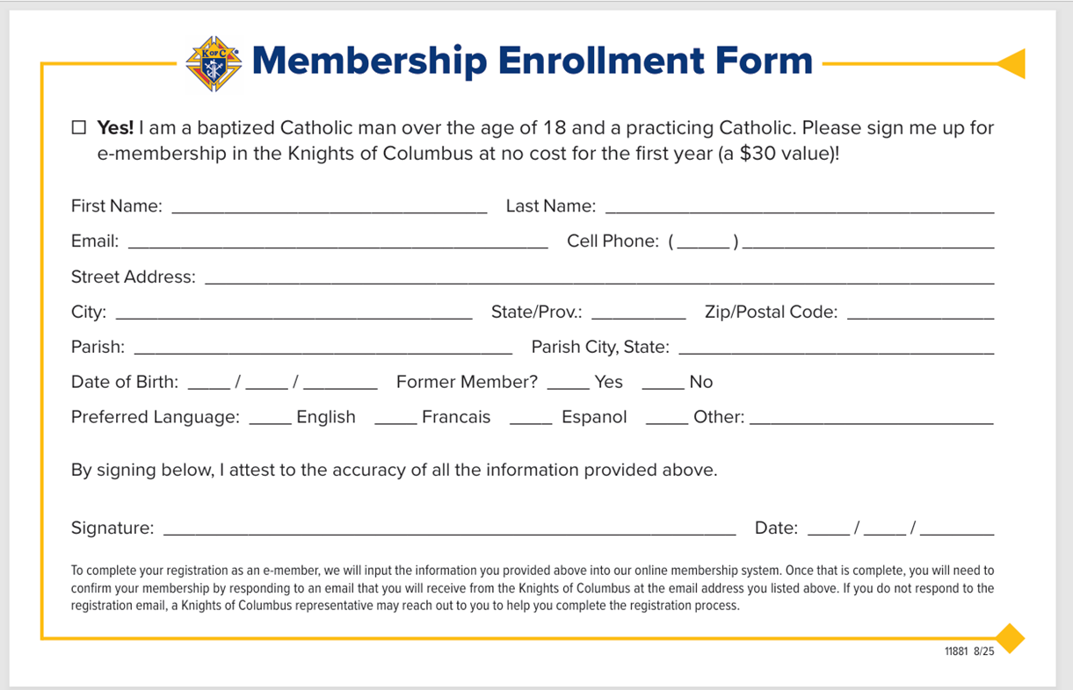

Slide 13
Becoming Fishers of Men
“It’s not about our number. It’s about our mission.”
FACTS:
-7 million Catholic men say they are willing to join the Knights
-More than half say “Hey, somebody needs to ask me...”
-But…33% of Knights have never asked a man to join.

Slide 14
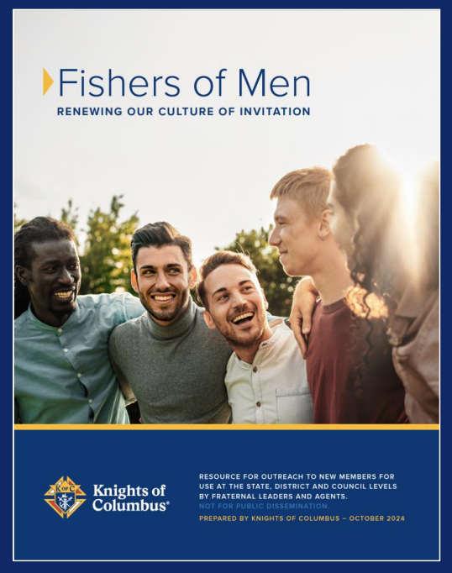
Becoming Fishers of Men
Free resources…
Fishers of Men Guidebook
“Point the World to Jesus Christ” Brochure
“On Mission” Invitations- invitation cards with envelopes
Join Online Card- business card
“

Slide 15
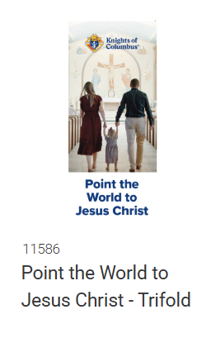
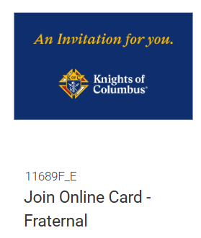
Becoming Fishers of Men

Slide 16
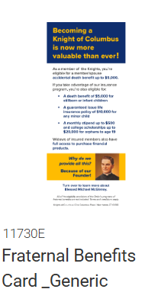
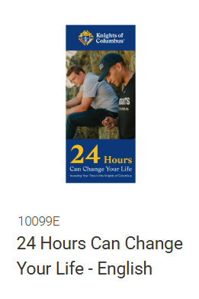
Becoming Fishers of Men

Slide 17
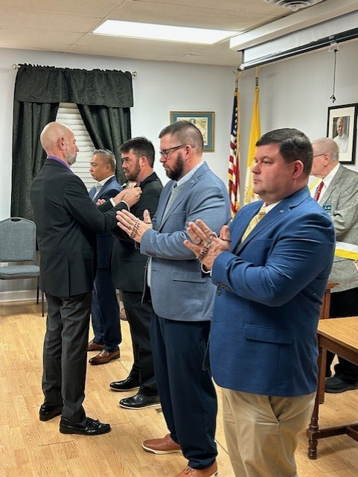
Church Drive & Exemplification Calendars
Goal: One exemplification per district per month
Submit updates continually
RGA Dave Czarnecki manages

Slide 18
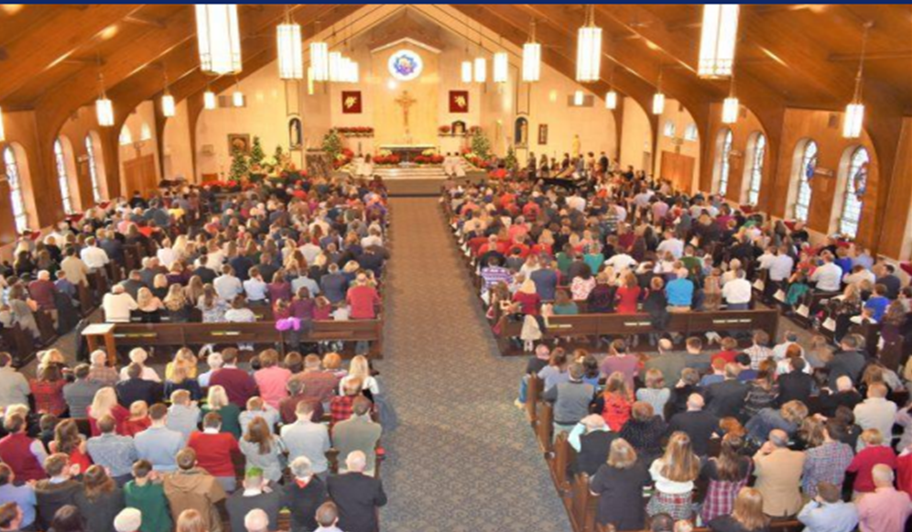
Delta Church Drive

Slide 19
What does success look like?
Schedule Church Drives – 3 per year
-Send schedule to State Council Growth Team
Schedule a Church Drive in each Parish the council supports
-Grand Knight should attend
Coordinate with the Pastor / get Pastor buy-in
-Provide Pastor talking points prior to the drive
-Suggest Pastor mention the Knights during his Homily
Remember to invite your Field Agent and Growth Advisor!

Slide 20


Recognition Awards
Shining Armor- first year Knight:
-welcome at least one
new member
Silver Knight- all Knights:
-welcome at least
two new members

Slide 21
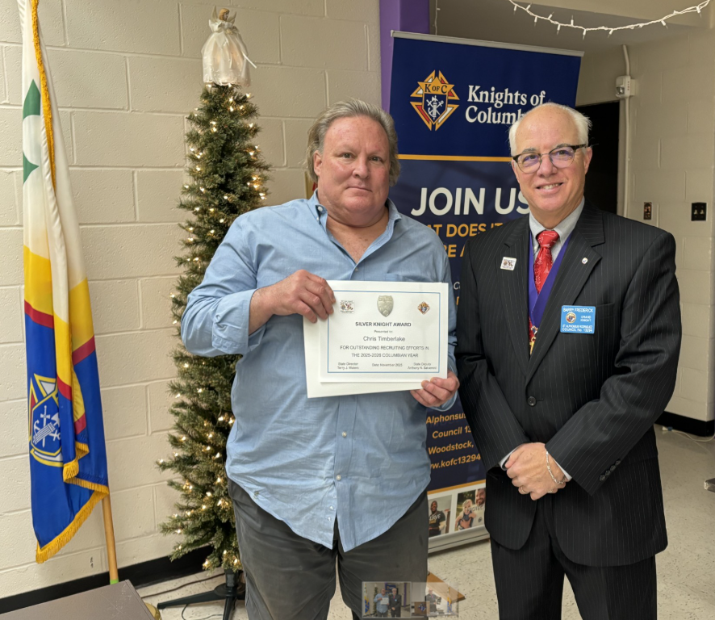
Recognition Awards
Council No. 13294
GK Barry Frederick
December 2025
Chris Timberlake
Silver Knight Award

Slide 22
Online Membership & Growth Update
Bill Newbrough – MD State Online Membership & Growth Director
“I’m very sorry I can’t join you Worthies!!

Slide 23
By the Numbers as of 12/23/25!
OLM 443 of 505 = 87.72% of Intake
65.91% Onboard Percentage of OLM
State | COH GOAL | COH YTD INTAKE | PCT to COH | OLM* | OLM PCT:COH | OLM Transfer to Councils | Transfer PCT
Connecticut | 969 | 491 | 50.67% | 447 | 91.04% | 280 | 62.64%
District of Columbia | 186 | 79 | 42.47% | 61 | 77.22% | 41 | 67.21%
Maryland | 1125 | 505 | 44.89% | 443 | 87.72% | 292 | 65.91%

Slide 24
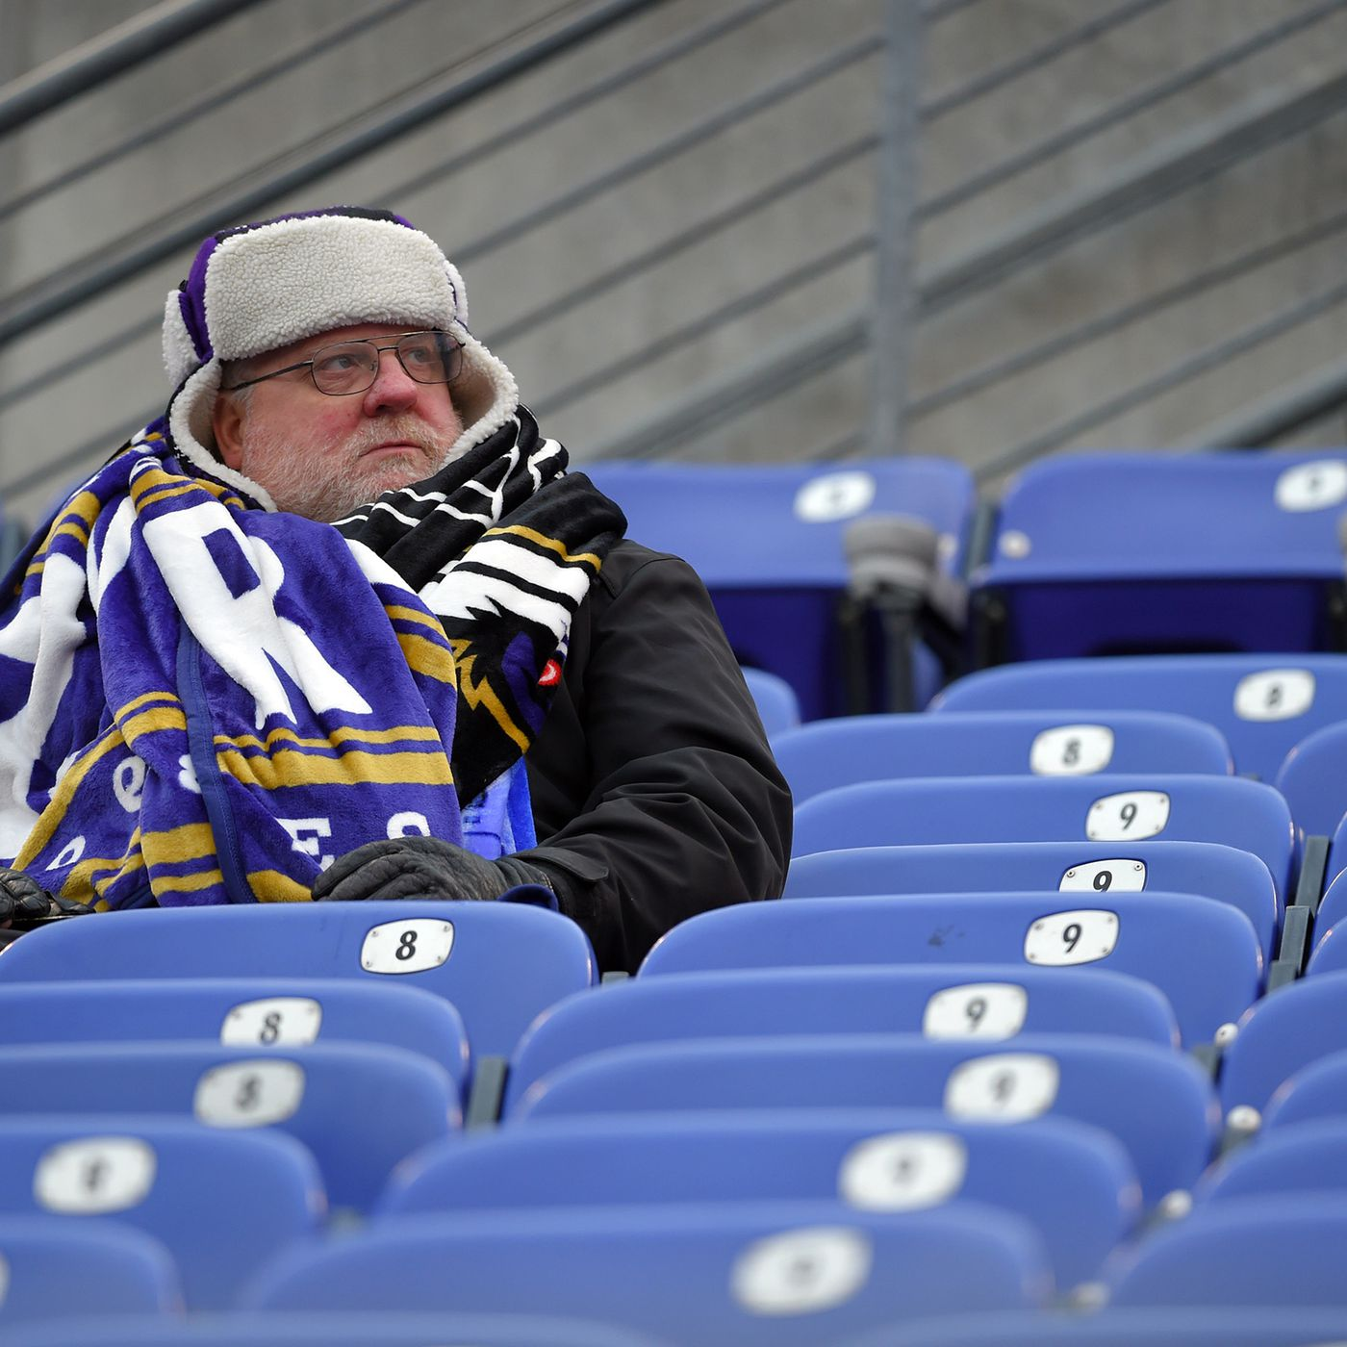
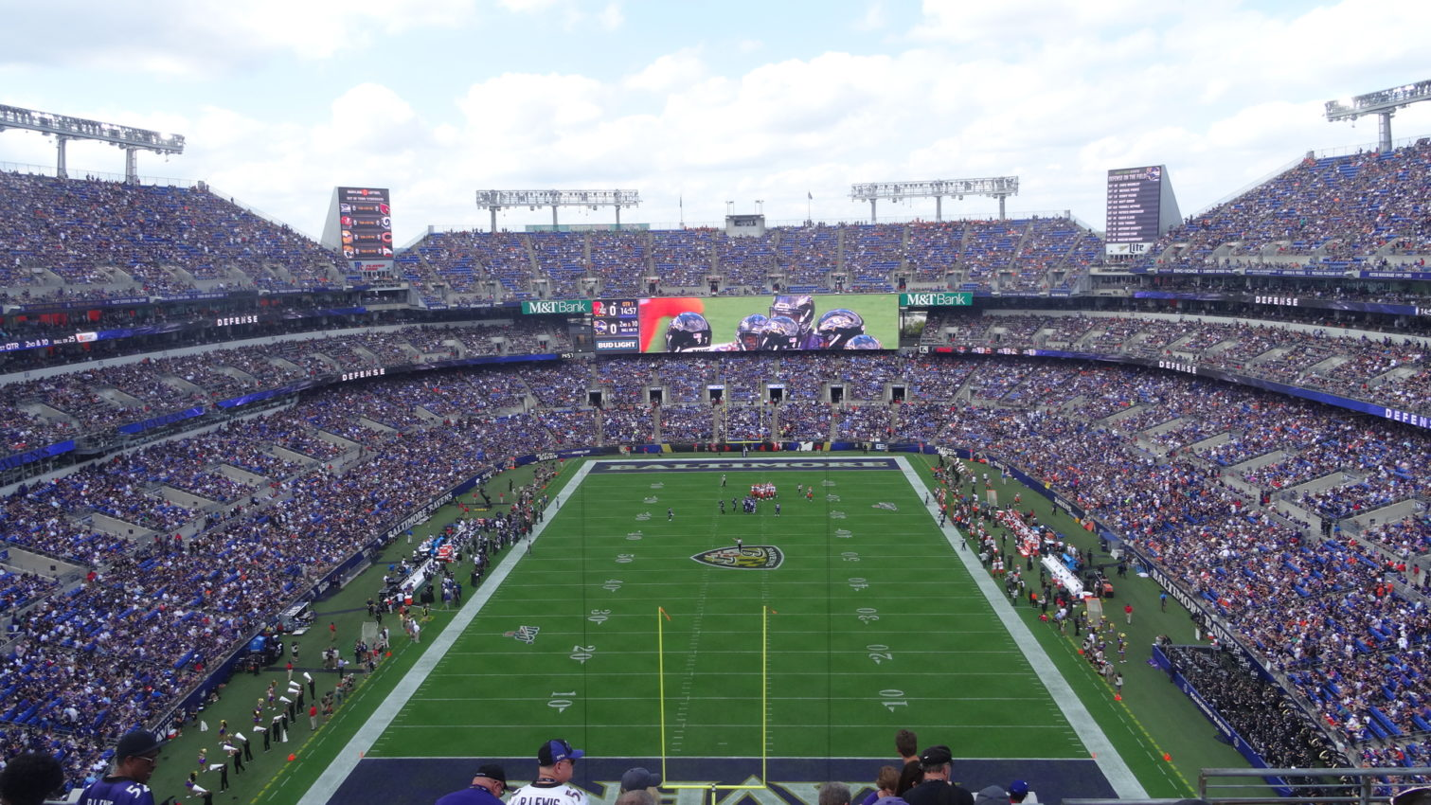
OLM is a game changer….Maximizing our outreach to potential new members by an order of magnitude!
To Join 365 days a year / 24 hours a day / 7 days a week
VERSUS

Slide 25
Benefits of Online Membership
FLEXABILITY - Meet Them Where They Are! Sign up new members on the spot or at their convenience – where and when it works for them!
EFFICIENCY - Member info transferred electronically
vs handwritten form in triplicate that must be manually entered at Supreme
COST EFFECTIVE - 1 Year Free Membership! “Blessed McGivney” Promo Code
INFORMATIVE – 10 WEEKS OF “KofC” 101 Week

Slide 26
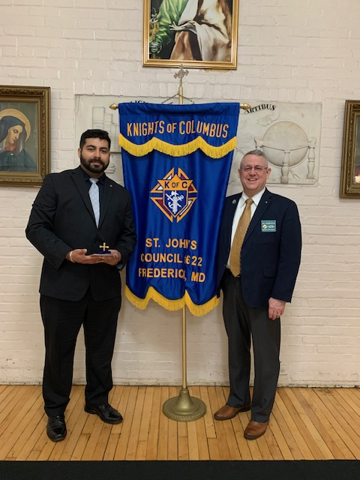
What’s the hold up?
According to Supreme, just over half of conversions to Councils occur within the first 47 days after joining Online.
What does that tell us?
Candidates report…”Nobody contacted me.”
Immediate outreach is essential!

Slide 27

Missing a Prospect?
Top Reasons
Didn’t complete the Online application / Email confirmation not confirmed
He is an out of state resident
He mistakenly entered the wrong Council #
He is already a member of the Order and created a duplicate membership

Slide 28
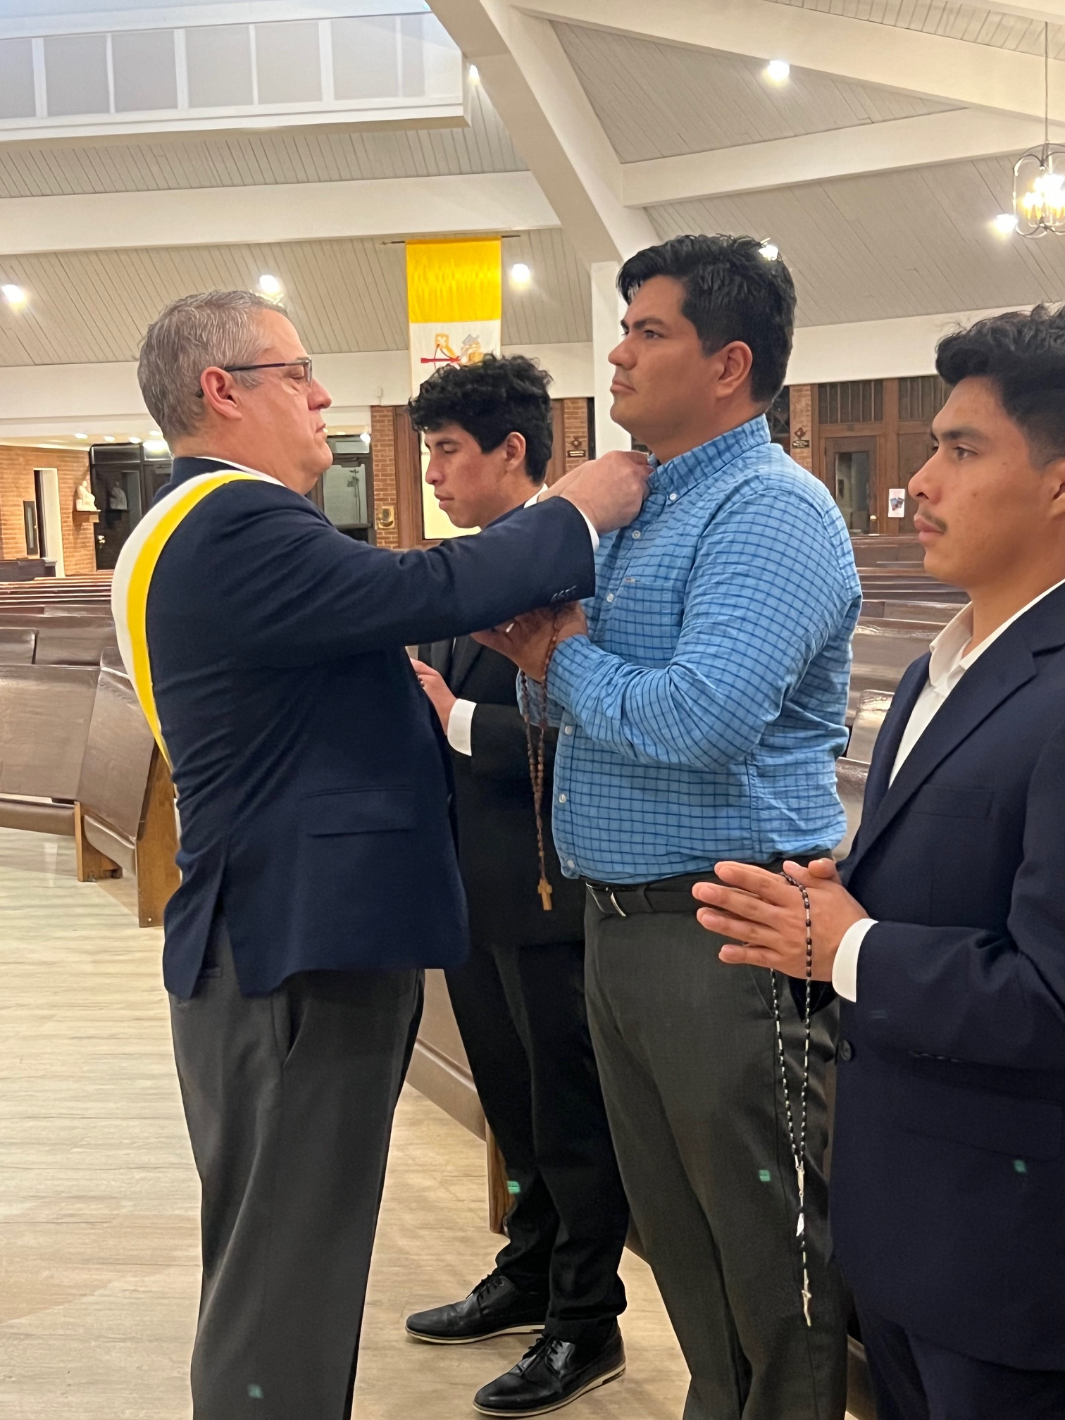
The Key To Success?
Tell your story! Be a visible force for good in your parish and community!
Issue the Invitation
Promote the Online Application Option
Welcome, Engage, Invite New Members to Council Activities
Exemplify New Members!

Slide 29
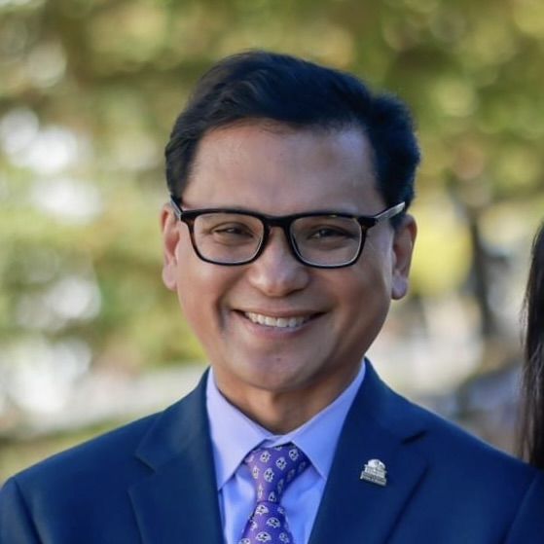
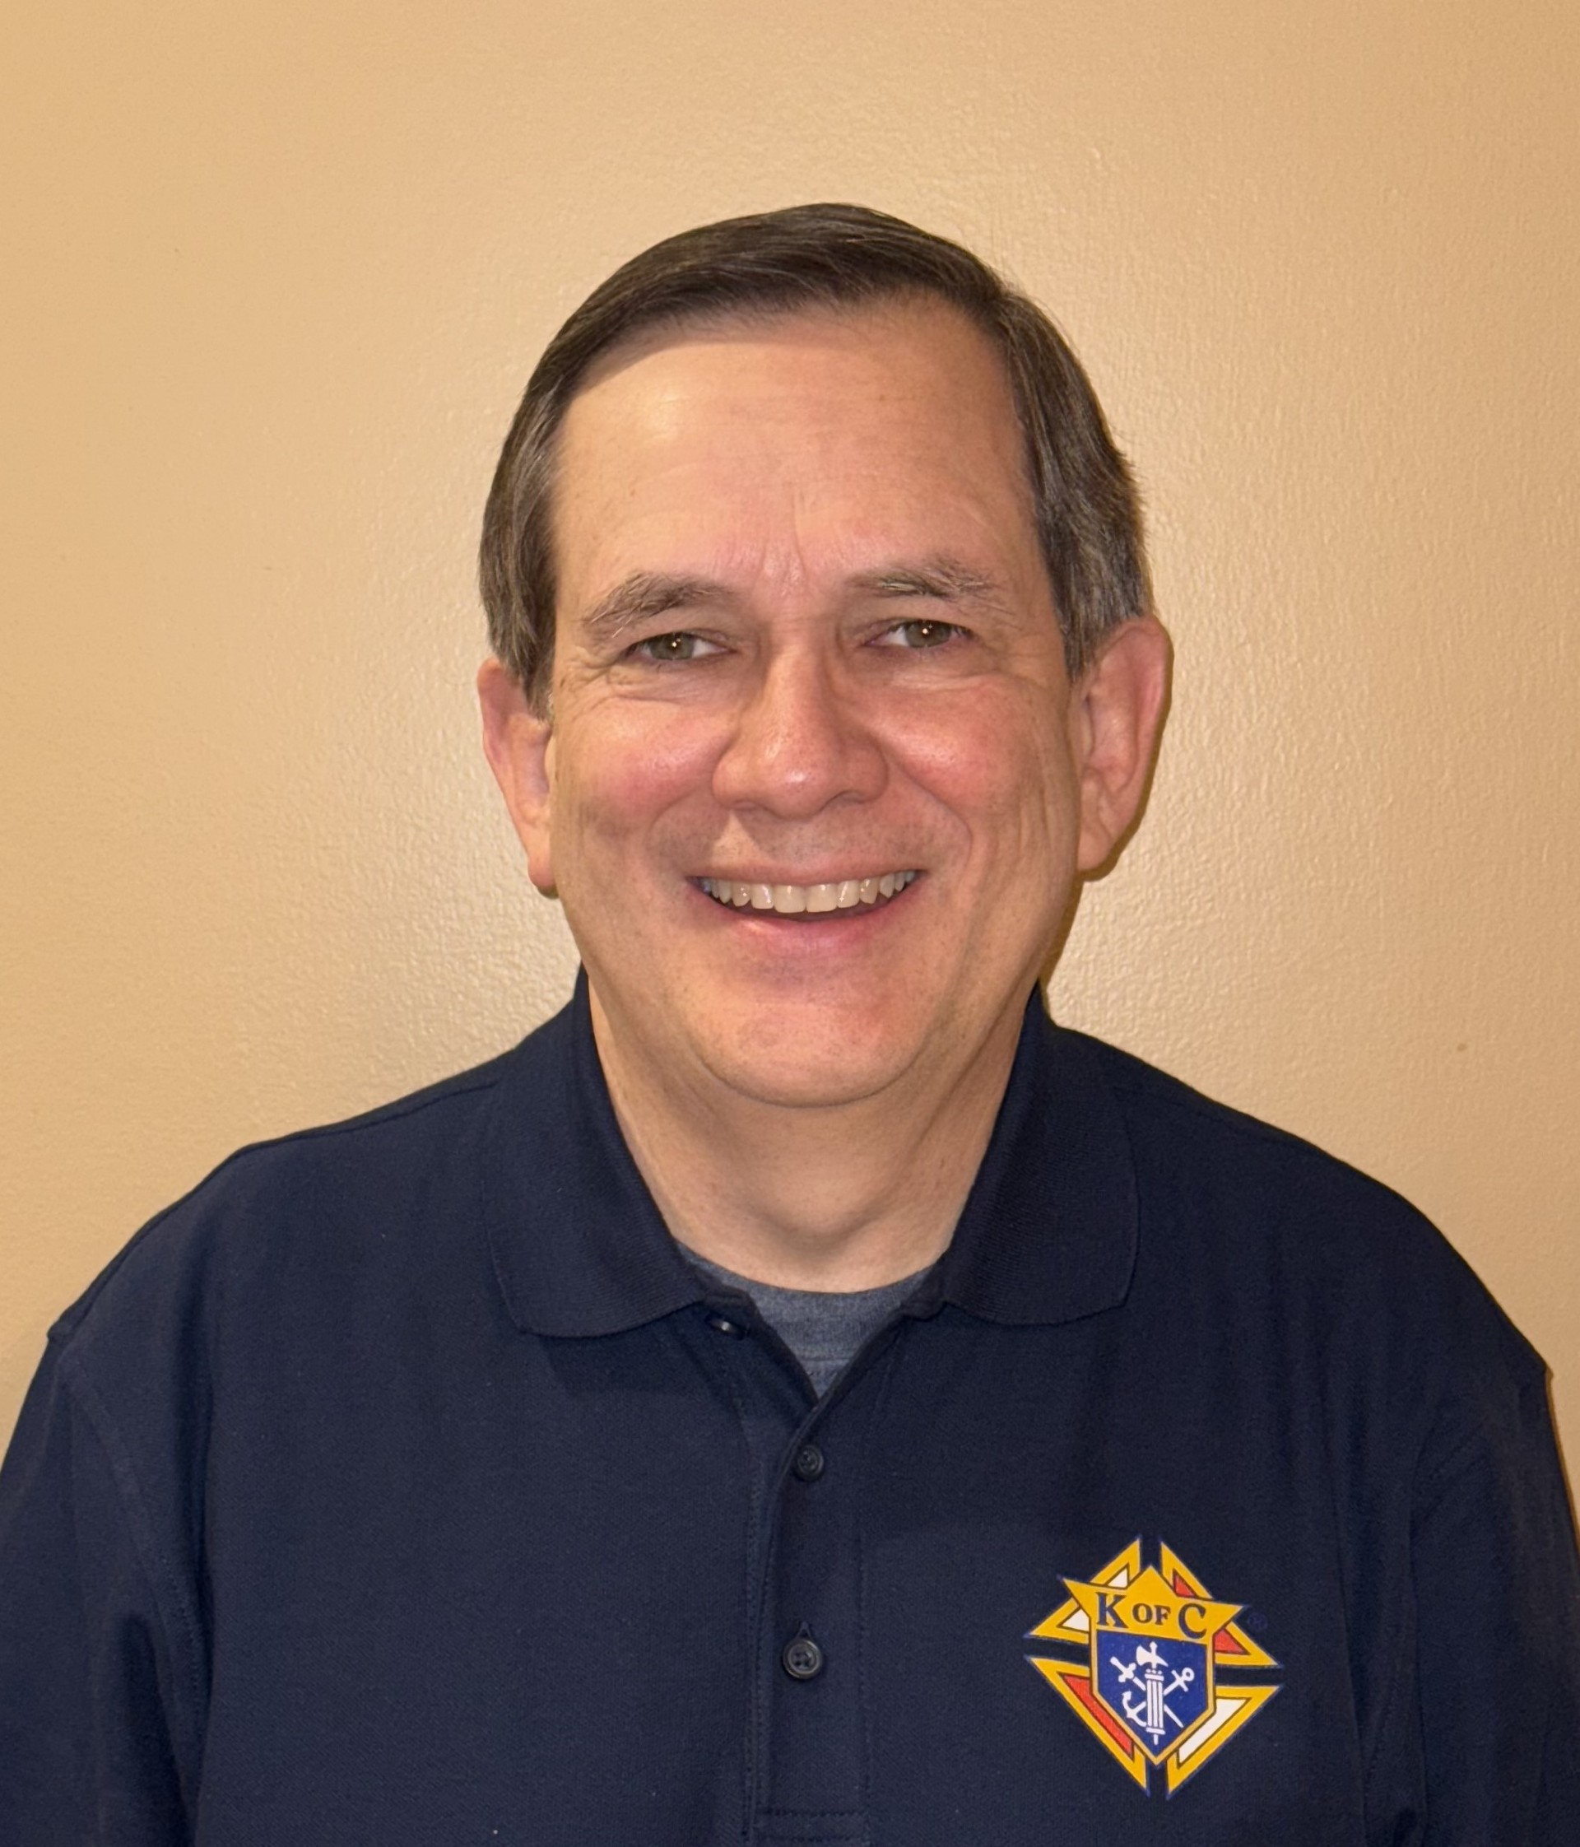
Guest Panelists
Jay Penafiel, MD
PGK Santo Nino Council
Jim Wasel
GK OLOG Council

Slide 30
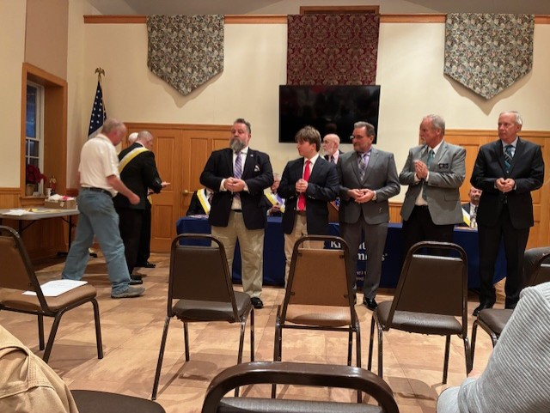
Mid-Year Meeting 2026
Membership Growth

