Slide 1

Dream Team

Slide 2
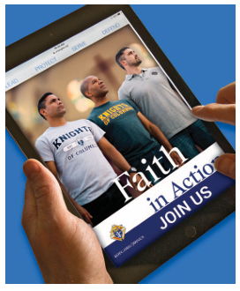
FIA Programs
Mid-Term Meeting
Alan Pultyniewicz
Program Director

Slide 3
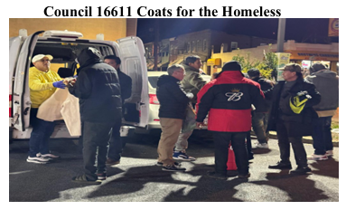
Programs Make a Difference
Engage
Support
Assist
Grow and Deepen
Meaning

Slide 4
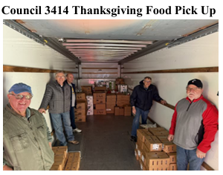
Councils Are Making A Difference
1,920 FIA Programs reported for the 1st Period (3/1-8/31/25)
1,781 FIA Programs reported for the 2nd Period (9/1-12/31/25)
3,701 times making a difference!!

Slide 5
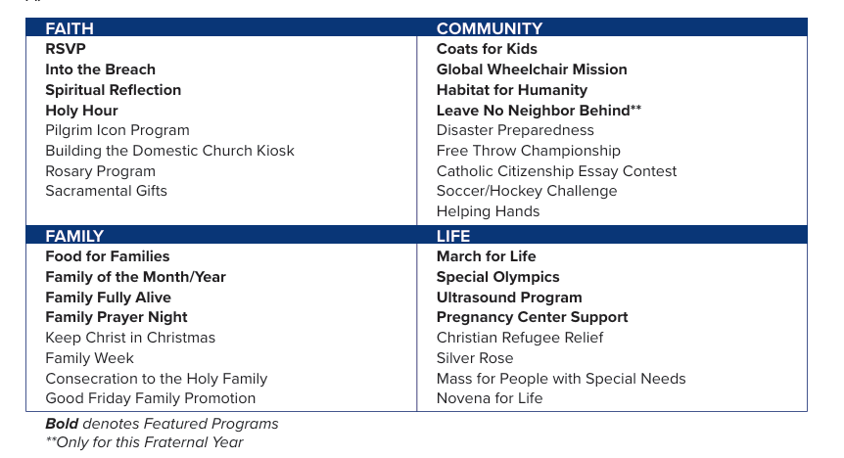
FIA Program Matrix Reminder

Slide 6




New Supreme Programs

Slide 7
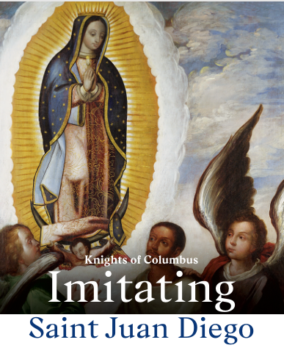
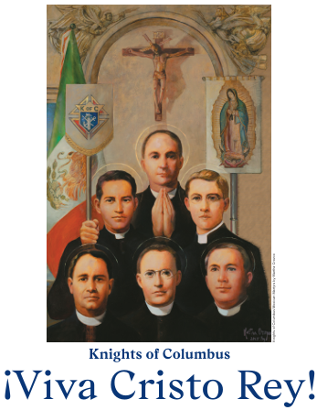
Faith
Imitating Saint Juan Diego

Slide 8
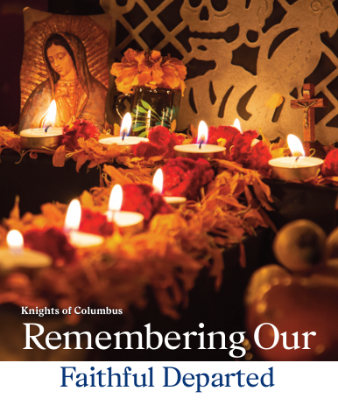
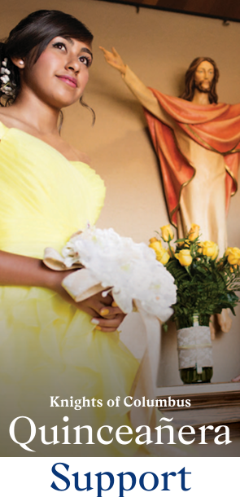
Family

Slide 9
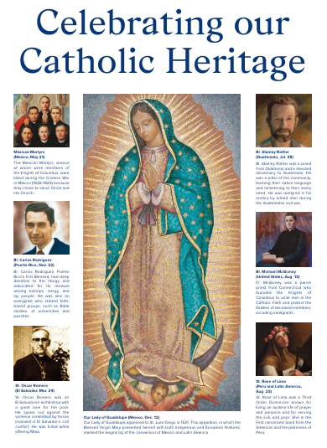
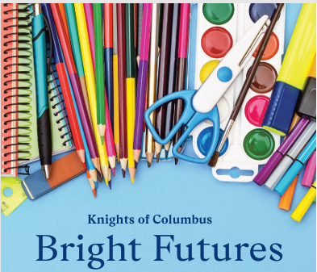
Community
Bright Futures
Celebrating Our Catholic Heritage

Slide 10
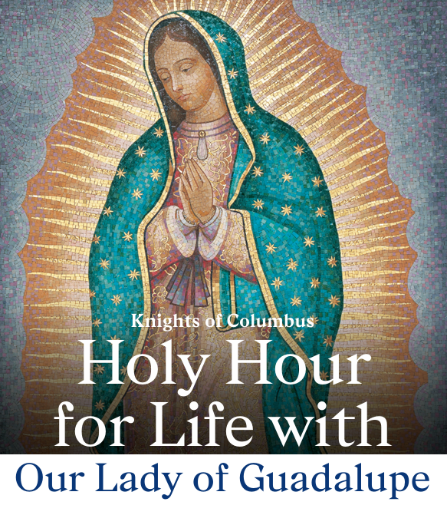
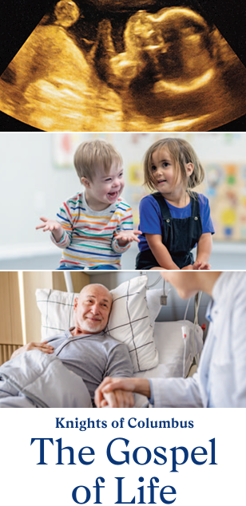
Life
Holy Hour for Life with Our Lady of Guadalupe

Slide 11
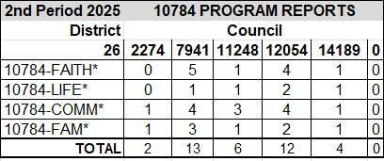
FIA Report Reminders
Check FIA tracking spreadsheet
Notify the state of discrepancies
Check often – at least monthly

Slide 12
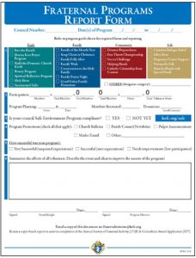
FIA Report Reminder
3rd Period reports (December 1st through February 28th)
Reports due March 7, 2026
Email copy to DD and reports@kofc-md.org if reports are not submitted in the month the program was held
Notify state of discrepancies

Slide 13
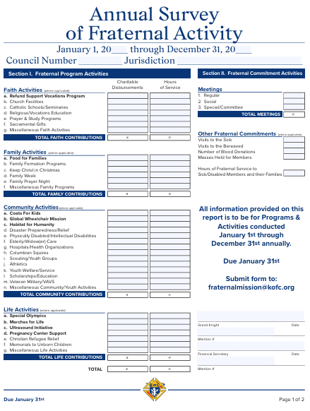
Annual Survey of Fraternal Activity
January 1 – December 31, 2025
Report on programs, activities, and donations from 1/1/25 to 12/31/25
Online form
Send copy to DD and reports@kofc-md.org
Due January 31, 2026
https://www.kofc.org/en/forms/council/fraternal_survey1728_p.pdf

Slide 14
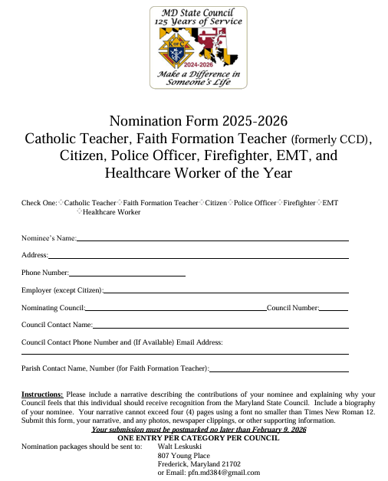
Recognition Awards
Council nominations for:
  Catholic Teacher
  Faith Formation Teacher
  Citizen
  Police Officer, Firefighter, EMT
  Healthcare Worker
Email nomination form and justification to Community Director Walter Leskuski: pfn.md384@gmail.com
Due February 10, 2026

Slide 15
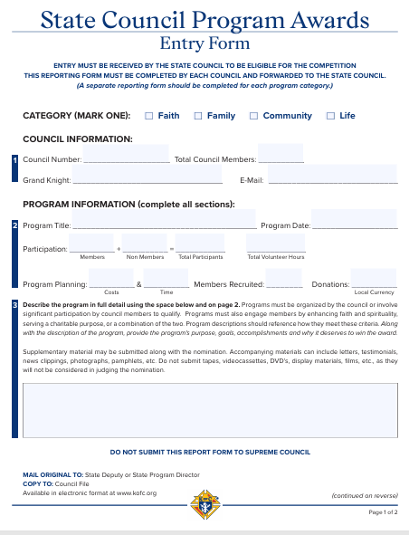
State Council Program Awards
Best Faith, Family, Community, and Life Program between 3/1/25 and 2/28/26
Include up to five (5) pages and photos/documentation
Combine and save as one PDF file
Email to Alan Pultyniewicz, State Program Director: apulty@yahoo.com
Due March 7, 2026
https://www.kofc.org/en/forms/council/state_serviceaward_p.pdf

Slide 16
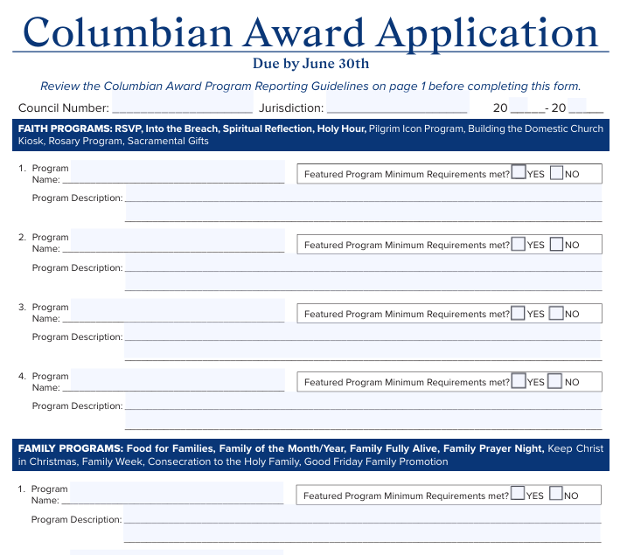
Columbian Award SP-7
Report FIA programs conducted during fraternal year (7/1/25-6/30/26)
Each Program is 1 credit; Featured Programs are 2 credits
Need 4 credits in each category: Faith, Family, Community, and Life
Submit online and send copy to DD and reports@kofc-md.org
Do not delay - Due June 30, 2026
https://www.kofc.org/en/forms/council/columbian_awardap_p.pdf

Slide 17
Upcoming Programs and Events
Sacred Heart of Jesus Pilgrim Icon - ongoing
Right to Life March – January 23, 2026
Catholic Men’s Fellowship Conference – March 14, 2026
Basketball Free Throw Championship – March 14, 2026
Founder’s Day Mass and Awards Reception – March 22, 2026
Family of the Month – ongoing
State Family Picnic – TBD
State Camping Trip – TBD

Slide 18
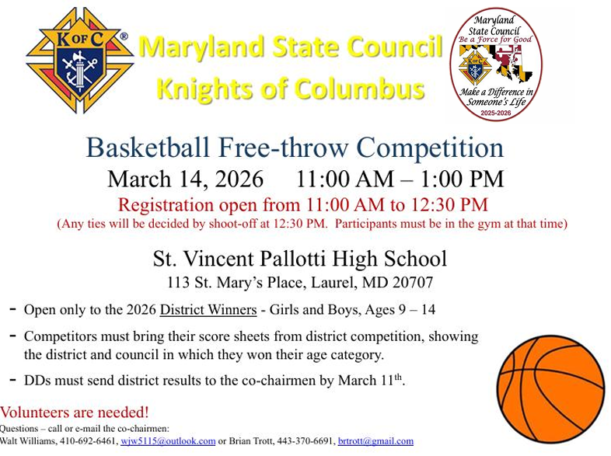
Upcoming State FIA Highlights

Slide 19
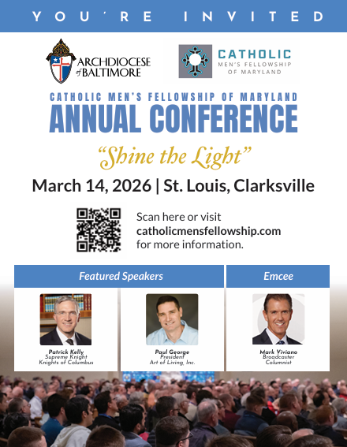
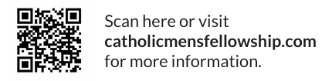
Catholic Men’s Fellowship Conference

Slide 20
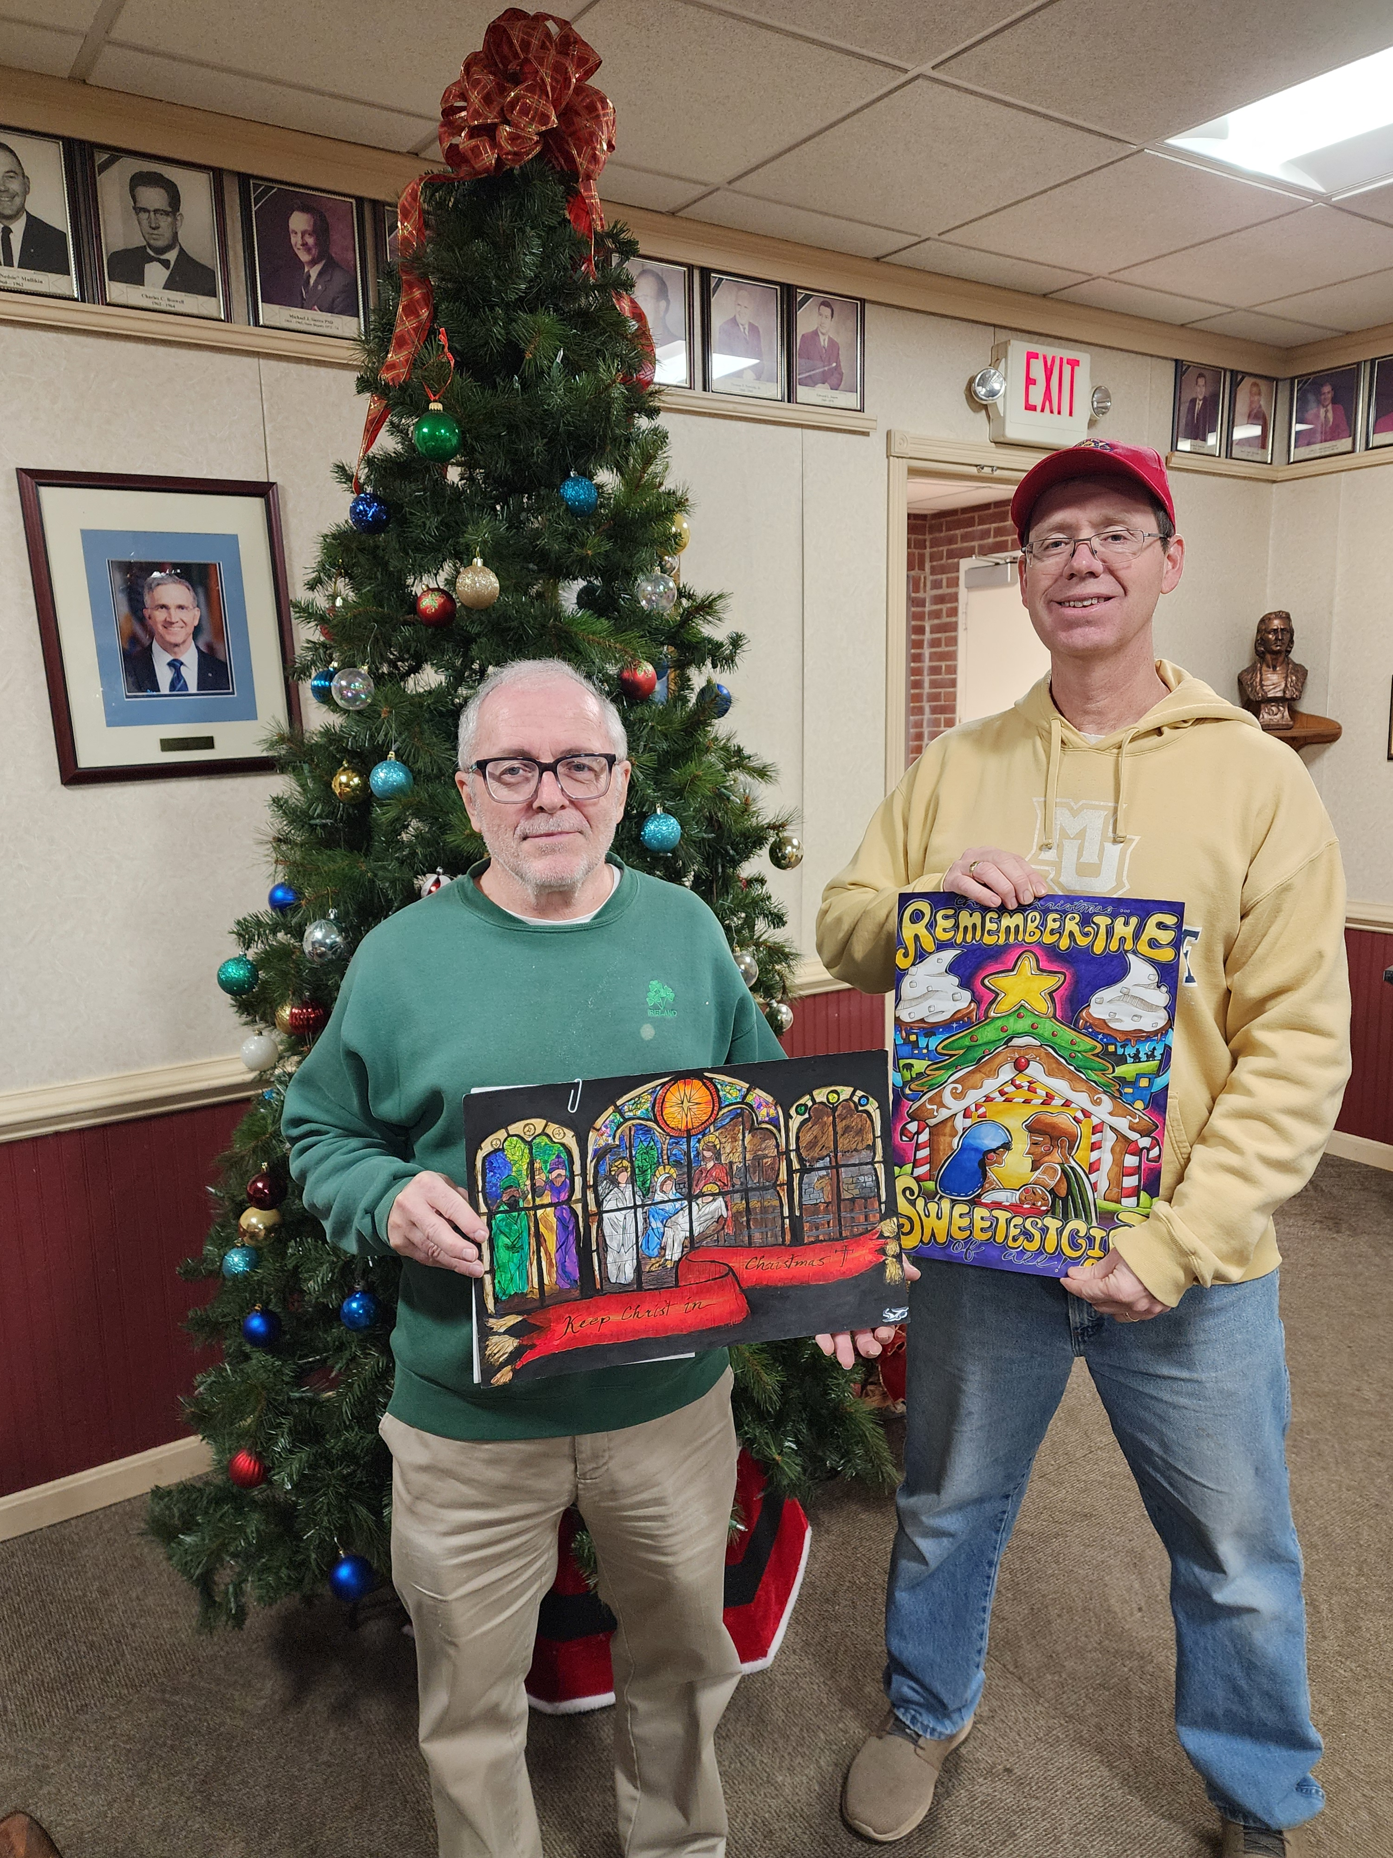
Keep Christ in Christmas
189 posters submitted
Kindergarten:
  1st Place: Westminster #1393
  2nd Place: Bethlehem #2605
  3rd Place: St. Mary’s #1470

Slide 21
Keep Christ in Christmas
1st-2nd Grade:
  1st Place: St. Mary’s #1470
  2nd Place: James C. Fletcher #11422
  3rd Place: Montgomery #2323

Slide 22
Keep Christ in Christmas
3rd-4th Grade:
  1st Place: Resurrection #11341
  2nd Place: Bethlehem #2605
  3rd Place: Bishop Becker #2427

Slide 23
Keep Christ in Christmas
5th-6th Grade:
  1st Place: Our Lady Seat of Wisdom #11259
  2nd Place: Havre De Grace #2002
  3rd Place: Bishop Becker #2427

Slide 24
Keep Christ in Christmas
7th-8th Grade:
  1st Place: Resurrection #11341
  2nd Place: Cardinal Gibbons #2521 / Fr. A. Leo Abendschoen #11615
  3rd Place: St. Katharine Drexel #14011

Slide 25
Your State FIA Team is Here to Support You
Program Director: Alan Pultyniewicz
410-491-8742
apulty@yahoo.com
Faith:
Michael Watson
mawatson64@yahoo.com
Family:
Tim Lynch
fdmdkoc@gmail.com
Community:
Walter Leskuski
pfn.md384@gmail.com
Life:
Rick Casazza
rcassazza1622@yahoo.com

Slide 26
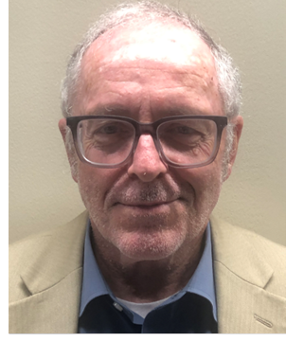
Family
Tim Lynch

Slide 27
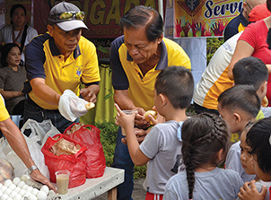
Food for Families
Ensure no one goes to bed hungry
Collect food and cash donations to support local food pantries, food banks and soup kitchens
Hold at least two food drives per year
  After Mass
  At council events
  In front of supermarkets

Slide 28
Food for Families
Set a goal: i.e., 5,000 pounds/yr
Supreme will refund $100 – up to $500 – for every 1,000 pounds of food collected or $500 donated
Counts for two credits toward the Columbian Award

Slide 29
Food for Families
Submit Food for Families Report Form to Supreme no later than June 30th https://www.kofc.org/en/resources/faith-in-action-programs/family/food-for-families/10057-food-for-families-report-form.pdf
Chair: Joe Feakes (josephfeakes@aol.com)

Slide 30
Family of the Month
Promote and support the development of strong and vibrant families
Each month, select one parish family that models Christian family values and visibly lives them every day
Establish a committee to recognize a deserving family:
  A member of your council or a parishioner
  Model Christian family values
  Visibly lives these values every day

Slide 31
Family of the Month
The husband does not have to be a Knight. If he isn’t a Knight, recruit that man!
Chair: Tom Devlin (devlins4@verizon.net)

Slide 32
Family of the Year
Honor families that made significant contributions to Faith, Family, Life, and Community activities
Councils select and submit one Family of the Month winner to be recognized as the State Council Family of the Year and as the potential international Family of the Year

Slide 33
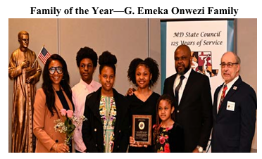
Family of the Year
The Father of the nominated family MUST be a Knight of Columbus in good standing
The International Family of the Year is chosen by the Supreme Council and will be recognized at the annual Supreme Convention

Slide 34
Family of the Year
Send nominations by February 10, 2026 to Vernon Hawkins: vhawkinsjr@aol.com CC: State Family Activities Director, Timothy Lynch: fdmdkoc@gmail.com
Award will be presented at Founder’s Day Recognition Ceremony on March 22, 2026
Nomination form – 10680 Family of the Year on Supreme website https://www.kofc.org/en/resources/faith-in-action-programs/family/family-of-the-month-year/10680-family-of-year-form.pdf

Slide 35
Widows Program
Blessed Michael McGivney founded the Order to assist our widows and orphans
What is important to widows?
  Acknowledge their beloved deceased Knights
  Keep their lives as normal as possible through support and encouragement
  Keep them informed and active in Council programs and activities – INVITE widows

Slide 36
Widows Program
What is your council doing?
  Create a contact list of widows and maintain regular contact with them
  Invite and include widows in council events
  Send birthday and Christmas cards
  Select a council member(s) to start an “adopt a widow” program
Chair: Paul Girolami (girolami@verizon.net)

Slide 37
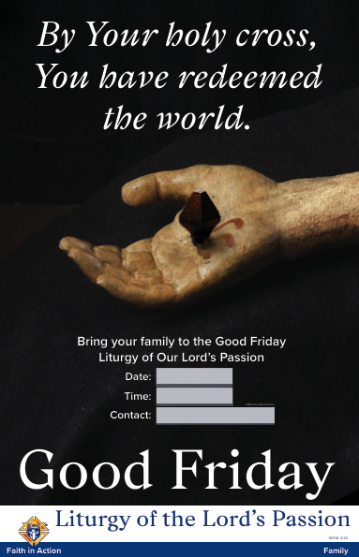
Good Friday Family Promotion
Help families better understand our Catholic faith and the Triduum
Conduct a promotional campaign to educate parishioners on the vital importance of Good Friday
Ash Wednesday is February 18, 2026
Start planning now!

Slide 38
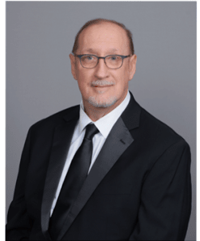
Community
Walter Leskuski

Slide 39
Helping Persons with Special Needs Update
During this fraternal year, 49 Councils participated in the Helping People with Special Needs Program
223 cases of tootsie rolls were ordered at a cost of $4,000.
The cost of the tootsie rolls remained the same as in prior years

Slide 40
Helping Persons with Special Needs Update
Councils collected approximately $93,000, netting approximately $89,000 after the cost of the tootsie rolls
73 checks were distributed to 58 organizations who help individuals with special needs
Thanks to co-chairs John Weaver and John Strawbridge

Slide 41
Little Sisters of the Poor
              17,000+ lbs. of food and requested supplies
              $12,000+ dollars donated to-date
Monthly collections ongoing; collection dates posted on State website calendar
Information in both English and Spanish is sent monthly with both general and specific needs

Slide 42
Little Sisters of the Poor
NOTE: If making individual donations, please inform your GK for increased tracking accuracy
Contact LSOP Liaison Rick Opatick, FDD with any questions for support needs, delivery options or how to get your council(s) involved in this program

Slide 43
Basketball Free-Throw
Competition
St. Vincent Pallotti High School, Laurel
Saturday, March 14, 2026 11 AM - 1 PM
  Registration is open from 11 AM-12:30 PM
Open to girls and boys, ages 9-14, and only to the 2026 District Winners
Competitors must bring their score sheets from District competition filled out
DDs must send District results to co-chairs Brian Trott and Walt Williams no later than March 11, 2026

Slide 44
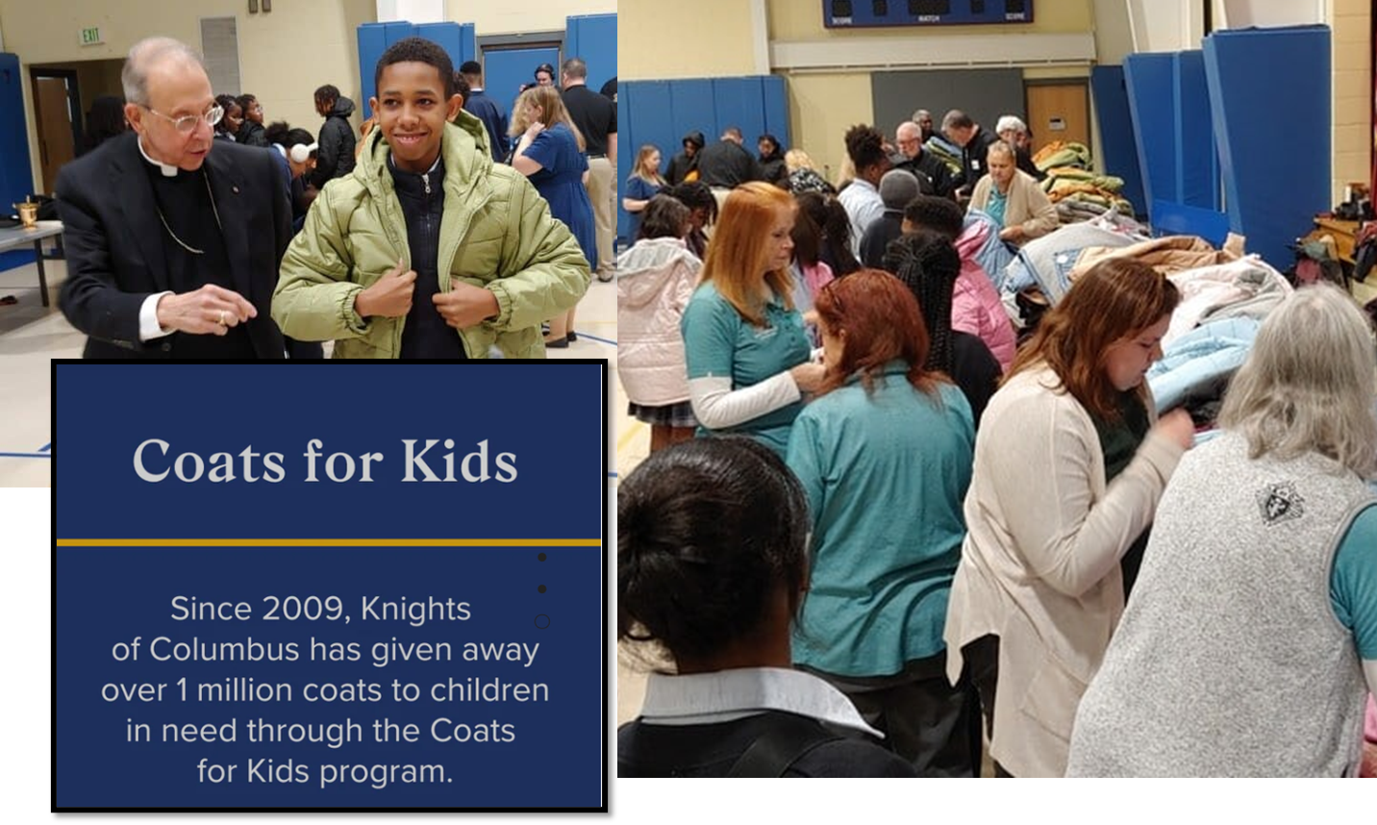
Coats for Kids Update
528 coats distributed to three schools:
St. Michaels/St. Clements, Mother Seton Academy, and Loyola

Slide 45
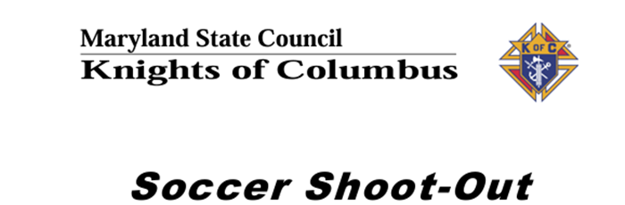
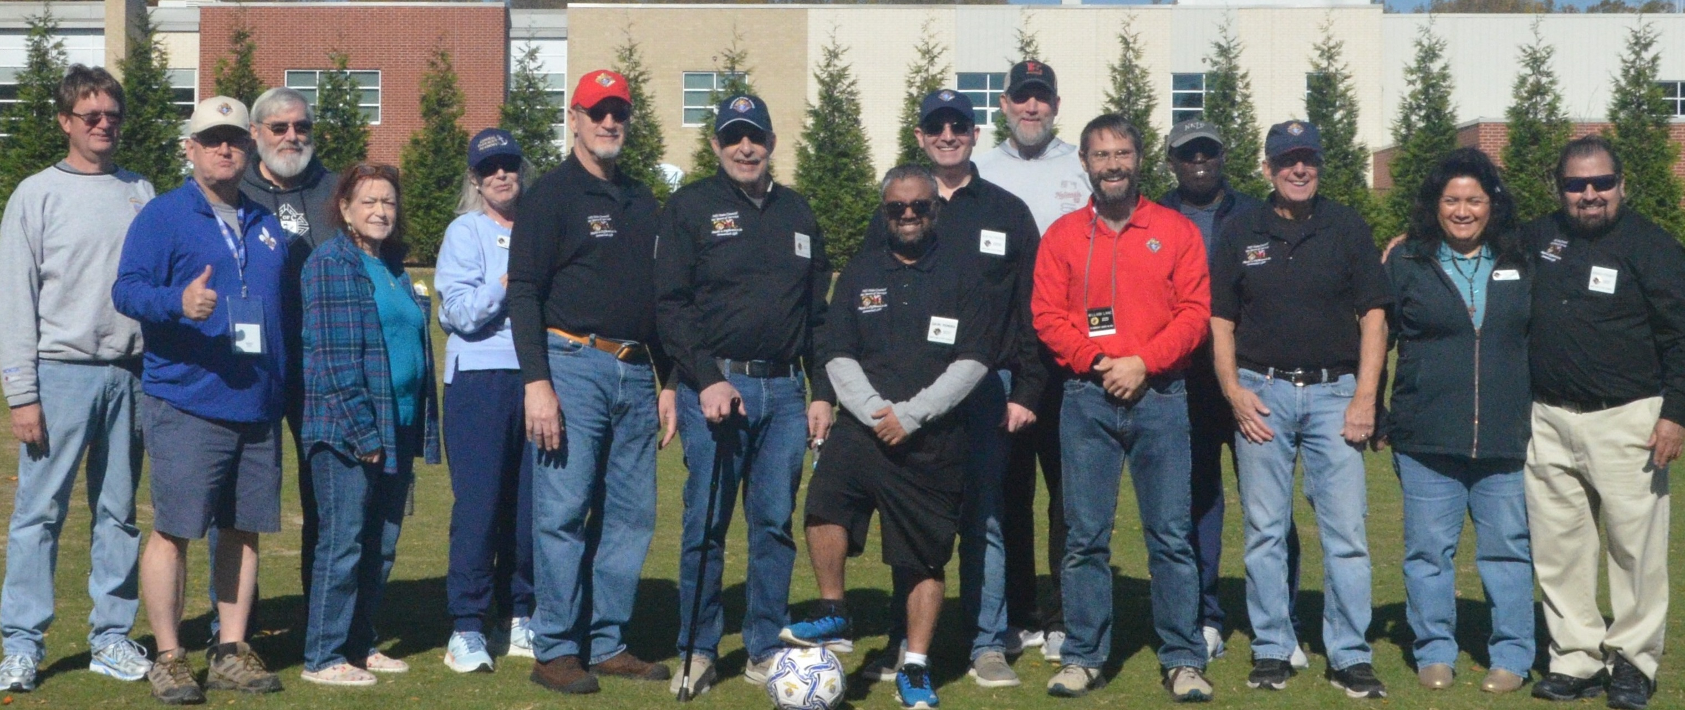
Soccer Challenge Update

Slide 46
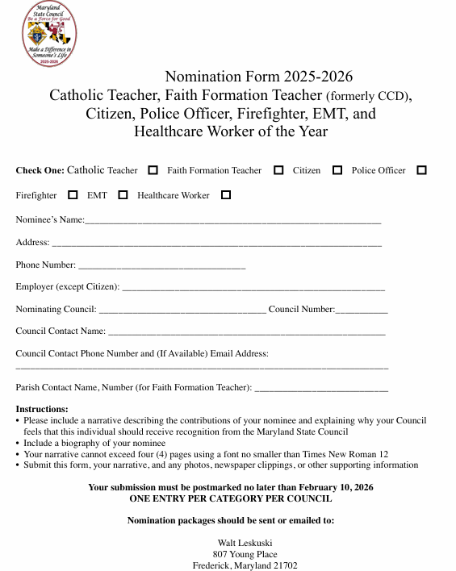
Recognition Program – Plan Now!
Council nominations for:
  Catholic Teacher
  Faith Formation Teacher
  Citizen
  Police Officer; Firefighter; EMT Worker
  Healthcare Worker
Email nomination form and justification to Community Director Walter Leskuski; pfn.md384@gmail.com
Due February 10, 2026
Link to forms on state web site

Slide 47
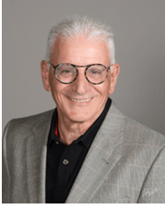
Life
Rick Casazza

Slide 48
Aid and Support After Pregnancy
Featured program supporting pregnant women, mothers, and their children by serving pregnancy resource centers and maternity homes
For every $500 a council donates in financial or material assistance to a non-profit pregnancy center or maternity home, Supreme will issue a $100 grant directly to the same organization
Grants are limited to $2,000 per organization
Maryland ranked 10th in the Order for the 2024–2025 Fraternal Year with 45 councils raising $138,473

Slide 49
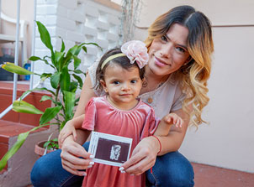
Ultrasound Program
  Congratulations:
  District 16: Councils 2002, 2427, 4714, 6188 & 9729
    DD John Marley; DW Stephen Michael
    Choose Hope Women’s Center, Edgewood
  District 18: Councils 2797, 5567, 9774, 13008 & 18156
    DD Gavin Pereira; DW Frank Boccovi
    Rockville Women’s Center, Rockville
  District 21: Councils 9638, 11341, 11898, 12524 & 13294
    DD Herman Stewart Jr.; DW John Sniezek
    Columbia Pregnancy Center, Columbia

Slide 50


Special Olympics
  No one has to get wet to serve or donate as an individual or team.
  For more information visit https://www.somd.org
  Dates to Remember:
  Deep Creek Dunk January 21; Deep Creek Lake
  Maryland Polar Bear Plunge January 31; Sandy Point State Park

Slide 51
For Life – Legislative Liaison
  Friday, January 23 - National March for Life on the National Mall, Washington, D.C.
    Volunteers needed to distribute free KofC signs and hats on the National Mall prior to the march
  Thursday, February 19, 2026 - Maryland Catholic Conference Virtual Advocacy Day
    One day, six issues, immeasurable impact
    hhtps://www.mdcatholic.org
  Monday, March 16, 2026 - Maryland March for Life, Saint Mary’s Parish, Annapolis
    https://mdmarchforlife.com

Slide 52
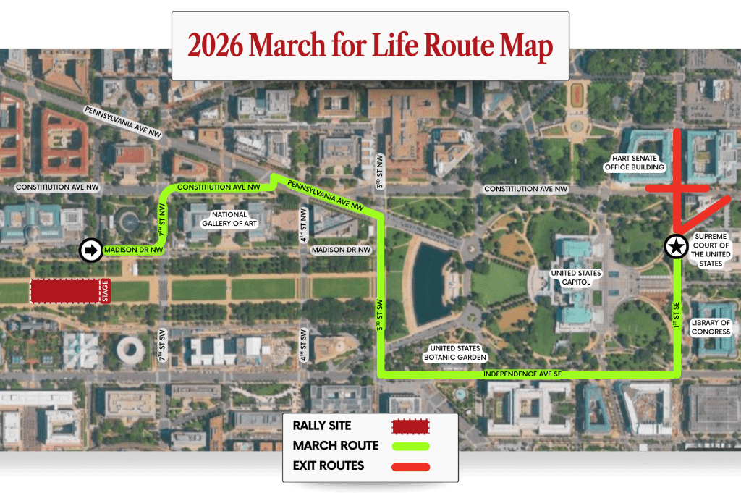
National March for Life - Jan 23rd
Rally and concert on the National Mall 11:00 am
March will begin at the conclusion of rally

Slide 53
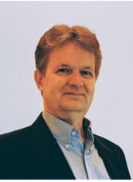
Faith
Michael Watson

Slide 54
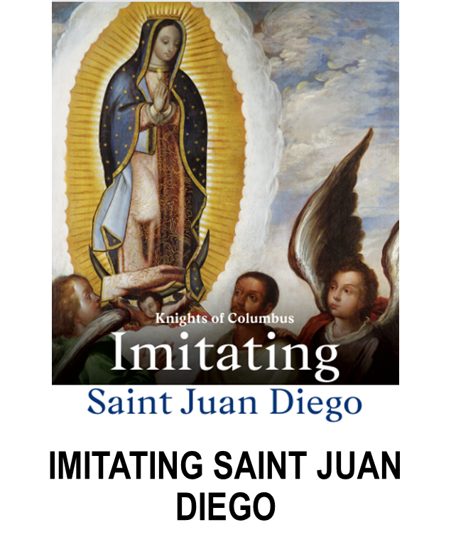
Imitating Saint Juan Diego
Featured Program - counts as two credits for the Columbian Award
Promotes devotion to St. Juan Diego and Our Lady of Guadalupe by offering parishes and families information on their lives and opportunities for prayer and acts of piety
St. Juan Diego’s feast day on December 9 and Our Lady of Guadalupe’s feast day on December 12

Slide 55
Imitating Saint Juan Diego
Coordinate a traveling image of Our Lady of Guadalupe - Available soon at Supplies Online
Conduct a prayer service in honor of St. Juan Diego or Our Lady of Guadalupe
Plan a retreat focused on living life according to St. Juan Diego’s example or the message of Our Lady of Guadalupe

Slide 56
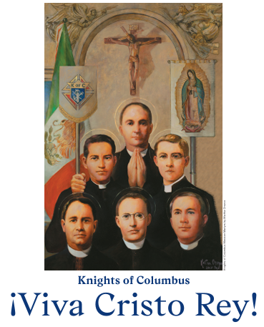
!Viva Christos Rey!
Featured Program - counts as two credits for the Columbian Award
Celebrates the sanctity of the Mexican Martyrs killed for their faith during the religious persecution of Catholics by the Mexican government in the early 20th century.
St. Luis Batis Sáinz, St. José María Robles Hurtado, St. Mateo Correa Magallanes, St. Miguel de la Mora de la Mora, St. Rodrigo Aguilar Alemán, St. Pedro de Jesús Maldonado Lucero - All Knights of Columbus

Slide 57
!Viva Cristo Rey!
Mass and Prayers leading to the May 21 feast day
Prayer service to the Mexican Martyrs Novena leading up to the Solemnity of Christ the King or the Mexican Martyrs’ Nov. 20 feast day which commemorates the following Knights of Columbus: Bl. José Trinidad Rangel Montaño, Bl. Andrés Solá y Molist, Bl. Leonardo Pérez Larios

Slide 58
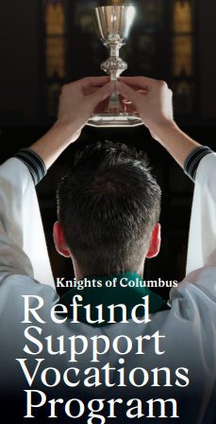
Refund Support Vocations Program
Featured Program - counts as two credits for the Columbian Award
Supreme Council refunds $100 to councils for every $500 given to a Seminarian (Form #2863)
“Pool Your Resources”
Councils “adopt” a Seminarian with not only monetary support but also moral, prayer, and engagement support

Slide 59
Refund Support Vocations Program
This Year’s Goal: 2 Councils for every Seminarian
Coordinate through the RSVP lead:
  Michael P. Davenport Sr. qstorm3@aol.com 301-523-7374
Results from the Nov DD Survey:
  Washington
    61 seminarians
  Baltimore
    54 seminarians
  Wilmington
    9 seminarians

Slide 60
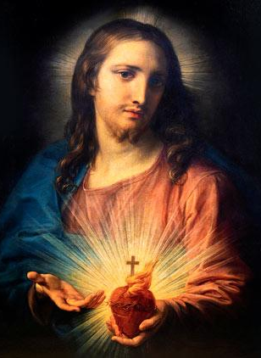
Pilgrim Icon: Sacred Heart of Jesus
350th anniversary of St. Margaret Mary Alacoque receiving her visions of the Sacred Heart of Jesus in 1674
Icon schedule has been released for this year
Schedule started in early November
Report Council participation with the Pilgrim Icon Program Form be sure to forward to your DD and reports@kofc-md.org

Slide 61
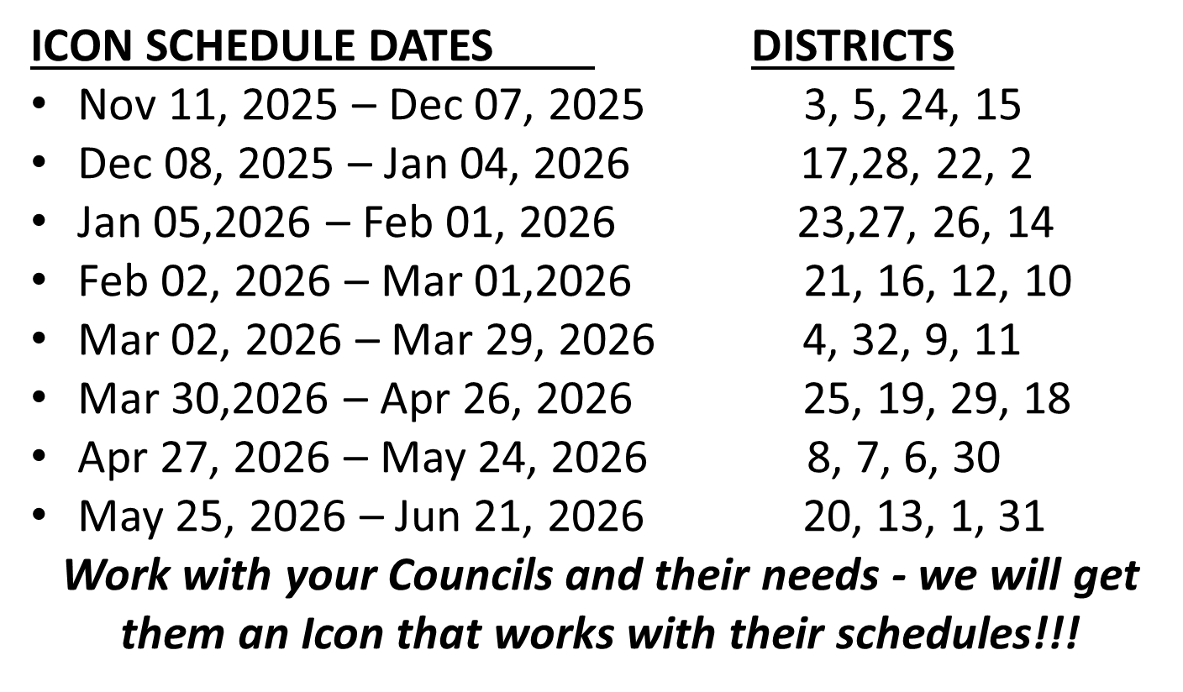
Pilgrim Icon: Sacred Heart of Jesus

Slide 62
Founders Day Mass/Awards
Founder’s Day Mass – Sunday, March 22
  St Joseph’s in Fullerton
  Mass at 3PM
  Awards Dinner after at Columbus Gardens
  Great opportunity to recognize those in our communities that serve and protect us!

Slide 63
Make a Difference in Someone’s Life
Be a Force for Good!

