Slide 1
Mid-term meeting for DGK/DW
SK John Winfrey
State Secretary
jwinfreykofc@hotmail.com

Slide 2
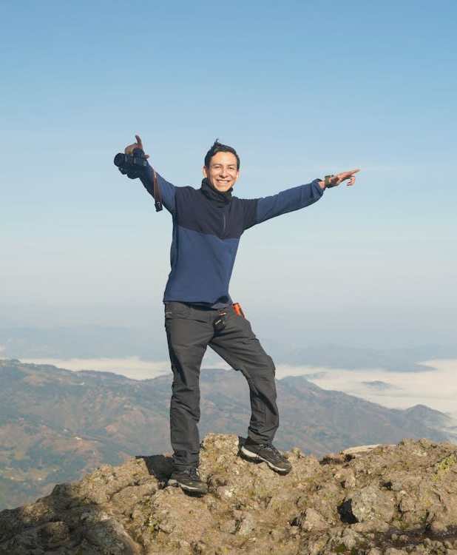
Why are we Here
Meet the “Dream Team”
Learn and understand the Directorection of the State Council
What are the priorities
What you can expect from the State
What is expected of you
Learn what you need to know to start Strong
Build a plan
Develop your message

Slide 3

Meet the Dream Team
Growth Director - William (Bill) Newbrough
Online Growth Director - Michael Watson
Program Director - Jeffrey Maynard
Faith Director - Jeffrey Koscho
Family Director - Armando Fernandez
Community Director - Emeka Onwezi
Life Director - Gus Gusman
Public Relations Director – Rick Askins
Training Director - Walter Leskuski

Slide 4
What are the priorities
Enhance the effectiveness of ALL Councils
Pinpoint areas requiring improvement
Assemble a dedicated Team
Focus on Long-Term goals
Foster stronger and more connected relationships with our Pastors and parishes
Recognize and encourage talent throughout the State
Reinforce to our brothers the reasons they chose to become Knights

Slide 5
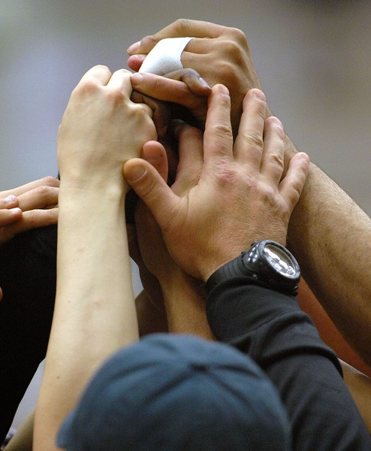
What you can Expect from the State Council
Assistance: Providing timely and effective support to address needs and challenges.
Availability: Ensuring consistent presence and readiness to respond whenever required.
Learning: Continuously acquiring new knowledge and skills to improve performance and understanding.
This Photo by Unknown Author is licensed under CC BY-SA-NC

Slide 6
What is expected of you
Effective Communication: Maintain open and transparent dialogue to foster understanding and collaboration.
Build a Strong Relationship with Your Pastor and Parish: Cultivate trust and mutual respect to support shared goals and community growth.
Plan and Prepare for the Future: Develop strategic plans that ensure continuity and sustained success for your Council or District.
Invest Dedicated Time to Enhance Your Council/District: Focus on strengthening organizational structures and community engagement before your departure.
CARE!!!!!

Slide 7

Build a plan
Avoid waiting until July
Assemble your ideal Dream Team
Program Directorector
Growth Directorector
Program Chairs
Begin planning ahead
Establish clear, written goals
Take advantage of the support offered by State and Supreme
This Photo by Unknown Author is licensed under CC BY-NC-ND

Slide 8
Develop your message
Appoint a Communications Chairperson
Develop a Clear Message (Define what you want to be recognized for)
Create a Communication Strategy
Website
Social Media Platforms
Email Campaigns
Phone Tree System

Slide 9
Summary
As we wrap up today’s meeting, remember: Let’s move forward together—communicate openly, build strong connections, and set bold goals. Use every resource to make a real impact. Don’t wait for change—be the change. Assemble your Dream Team, lead with care, and let’s make this year unforgettable. The future is in your hands!

