Slide 1
Deputy Grand Knight
Training for Success

Slide 2
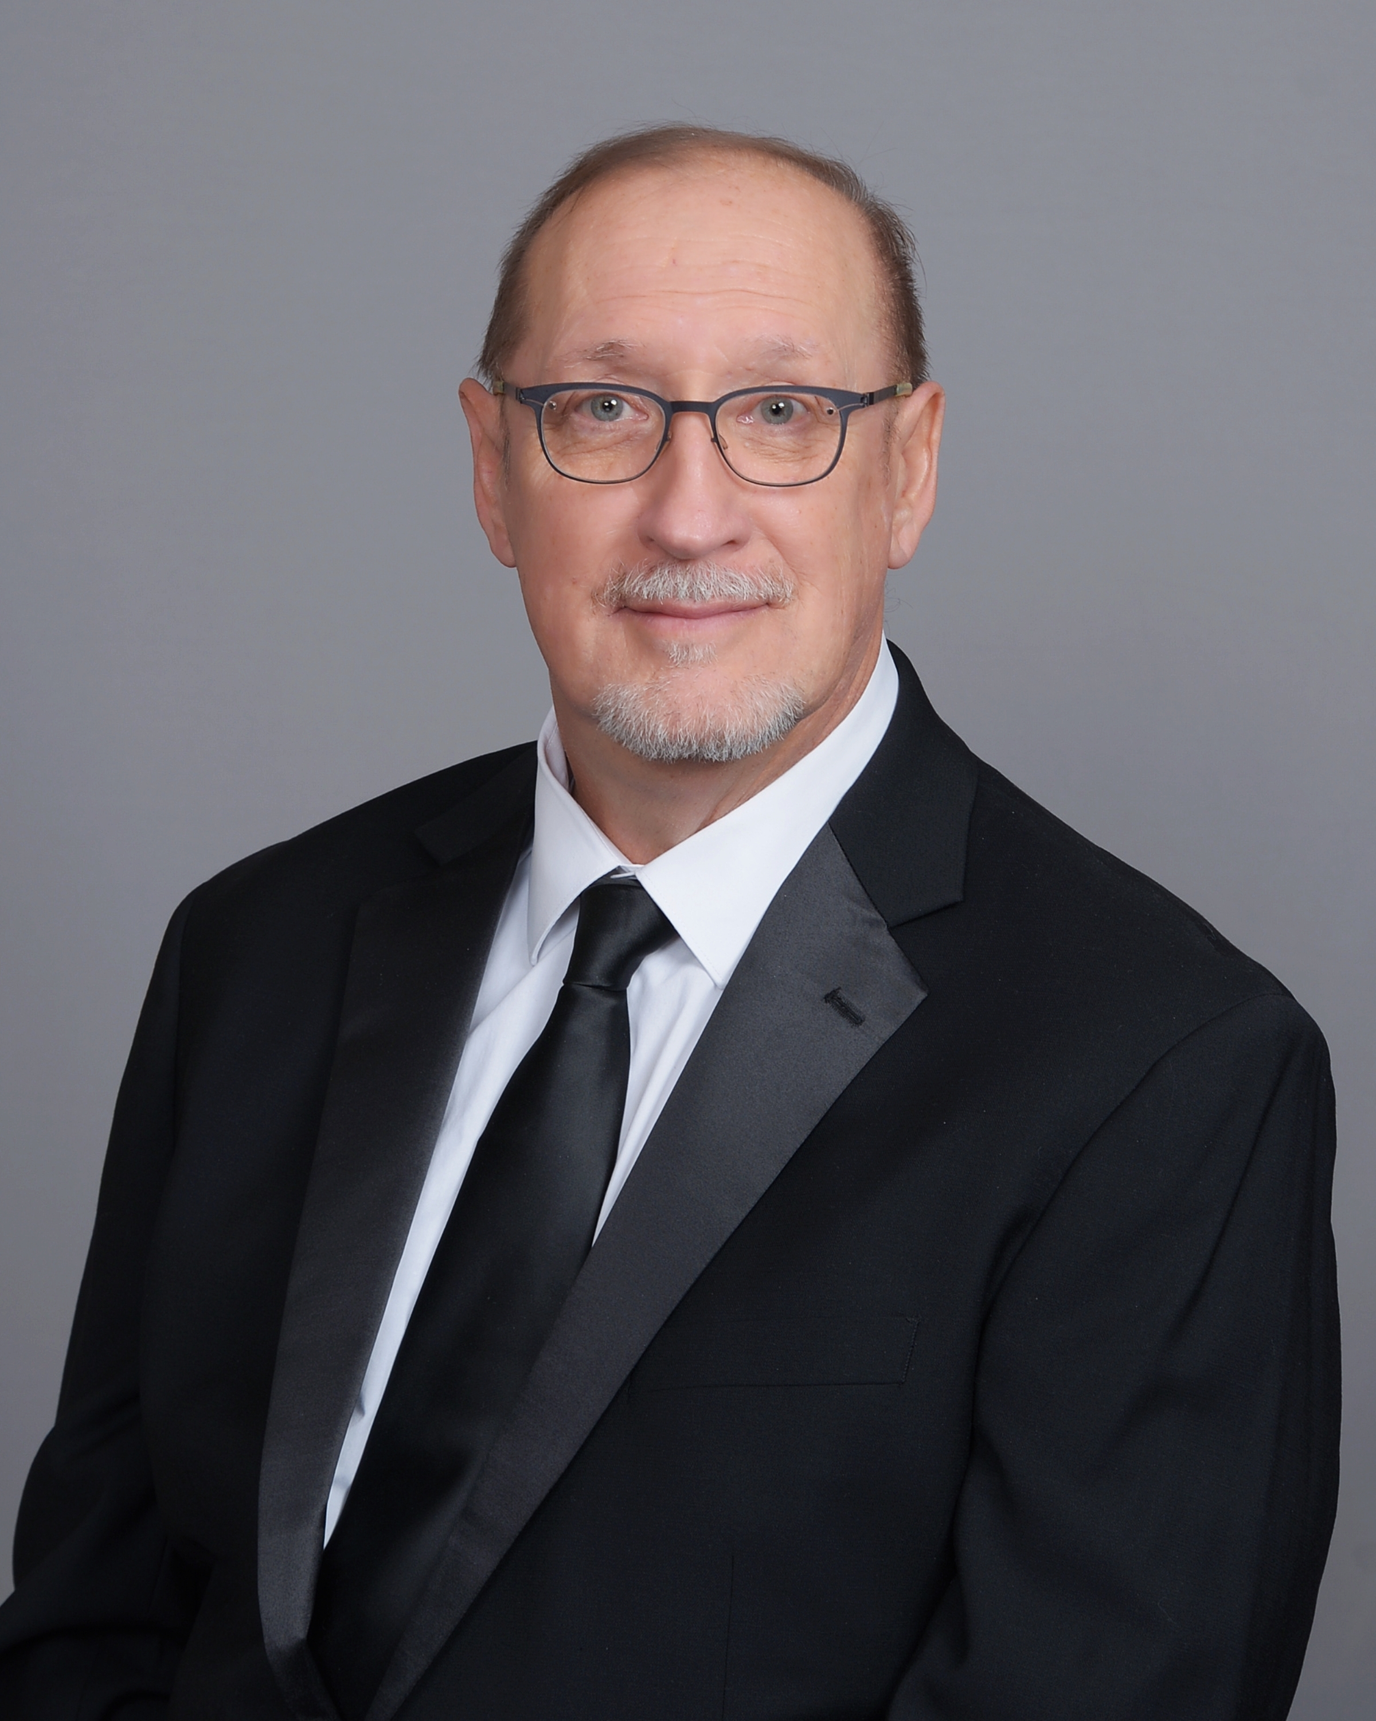
Council #14011, Saint Katharine Drexel
Assembly
Chapter
Community
Why share all this?
  We have a lot in common:
    I have been in your seat and I knew I would be needing support
    I want to help men who believe in Blessed Michael J. McGivney’s vision
    My core beliefs are the same as your’s

Slide 3
Training Strategy and Philosophy
When questions arise in your council about programs or leadership our goal is to be there for you to provide solutions. Let us help you!
Our Philosophy is:
  Empowering men to help councils delivering solutions for both the general and specific
Our strategy is:
  Reenergize leadership development and to help grow council leadership, if needed
  Provide assistance with any new or existing program(s)
  We are going to provide you the functional training (tools) for success with web events on “how to” on a variety on topics

Slide 4
Supreme Training
Fraternal training is divided into four categories which are update frequently. You can watch on-line or at your leisure. The sessions are recorded. Refer to www.kofc.org/training
  Online
      Information for Fraternal Leaders
      Focus on Council Officer Training
  Fraternal Training Webinars
      Information for Council Operation, Recruitment and Programs for the entire Council
  Resources
      Additional resources for Fraternal leaders and Faith In Action additional Resources
  Fraternal Video Library
      Short tutorials for essential tools and Procedures

Slide 5
State Leadership
Our primary focus is to help you succeed as a council leader
We have a proactive asset to leverage to provide assistance and it’s called the SWAT team
Training will work with the SWAT team to overcome specific council challenges impeding your progress. We are the business of building bridges not barricades.

Slide 6
State Leadership (cont)
To jumpstart the training for this year we are will be hosting three (3) web sessions after the Mid-Term on various discussion topics. Stay tune, more on this shortly
We are here to make your job easier. We work for you to lead
Lastly but most important!
  I want to leave you with this — you are not alone in this journey. We are here to work in lockstep with you and your council to ensure you have a very successful year

Slide 7
Take Aways Reminders
Subscribe to the Supreme Leadership advisory newsletter
  Provides latest updates and valuable leadership
After reviewing the Supreme training look at your team and direct them to the resources they need
  This will help in the long run. Can share this information at the appropriate time. If you need us to help, please do not hesitate!
  It would be beneficial to specify which individuals need the training and direct them to the appropriate resources

Slide 8

Questions

