Slide 1

If you get your message right, everything else will fall into place
K of C
Public Relations

Slide 2

Your Changing Role in the Council
Your Role in the Council is Changing
As DGK
You’re more involved in planning your Council Communications
Planning a good PR strategy is an essential part of an overall Communications plan

Slide 3
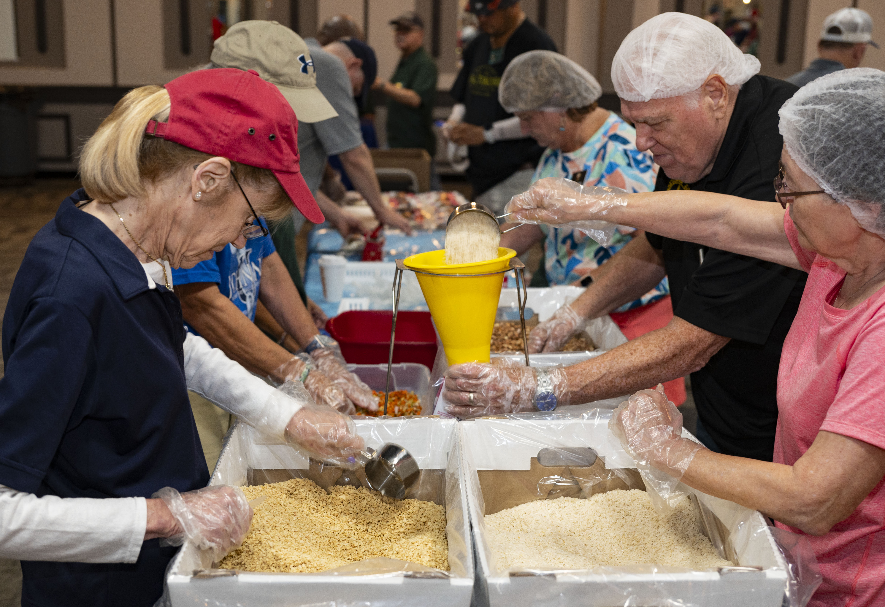
Is PR worth doing? Food Packing Event

Slide 4
Is PR worth doing? Creating Interest and Involvement
Our Chairty Work is second to none!
But sometimes it is a Best Kept Secret!
Without PR, how will people know they will want to be a part of our great work?
PR Creates Interest
Keep current members interested
Get potential members interested
Need Church or Community Involvement
Remember other organizations are competing for people’s time!

Slide 5
Examples of Why PR
Activities
Hosting a Major Fundraiser
Community Food Pantry, or Pregnancy Center
How to get a great turn out?
Recognition
Members or Community Recognition
Family of the Year, Knight of the Year or Council Awards Community Awards, Teacher of the Year, Policeman of the Year, etc.
Council Milestones
Anniversaries, Major Achievements
How do we use PR to make things happen?

Slide 6

Power of Words Building Your Council
Don’t Forget the Power of Words!
Use words that create
Impressions
Urgency
Motivation
Inclusion
Become a Builder
Use your words to make Change

Slide 7

Format and Layout
Format and Layout
Sometimes it is how you say it that makes all the difference
Think about the title of the article
What to say first
Get people’s attention
Keep them reading
Council Hits New Record!
Joe Smith incredible Achievement

Slide 8
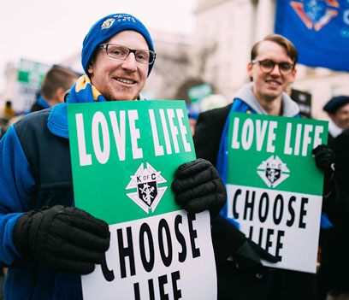
K of C Branding
Impressions
Trust
Emotions
Belief
Organizational Branding
K of C has a unique and powerful brand
What message do we send when people see our Emblems, Motos and Photos

Slide 9
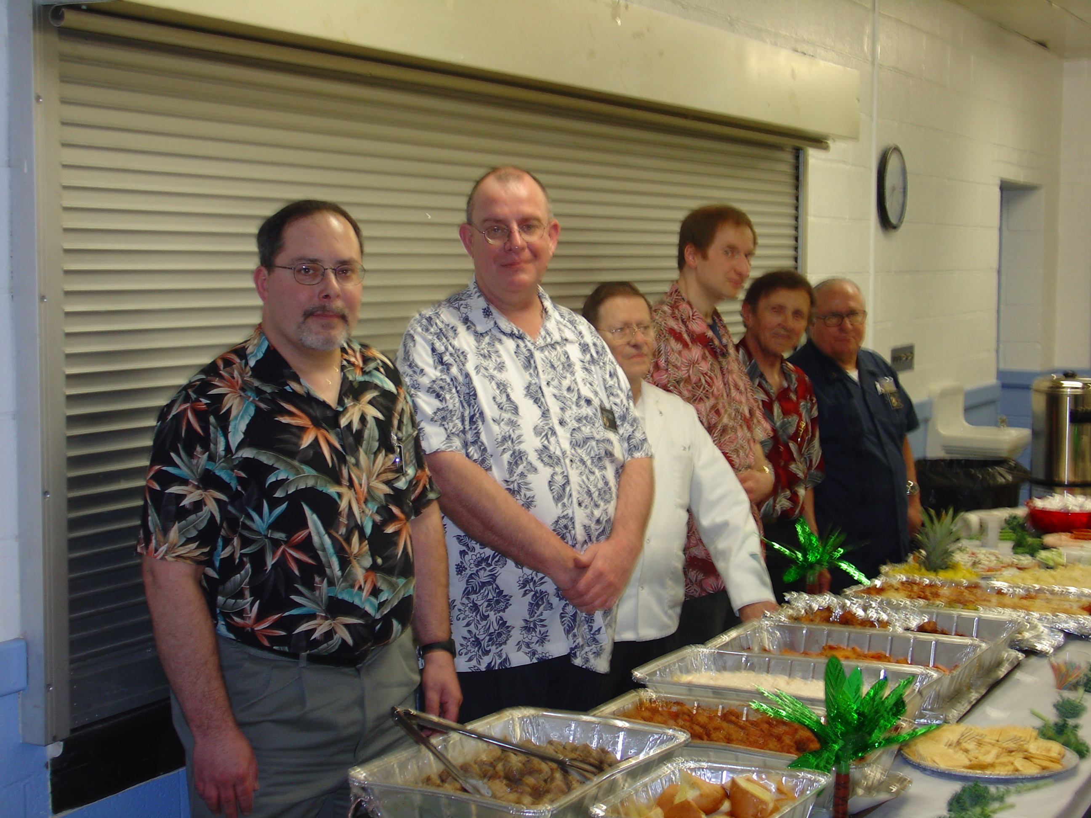
Council Branding
Faith
Fun
Family
Food

Slide 10

Promotional Material
Creating Promotional Material
Ads and Posters
This will take some design work to make it look good
Artwork and design catches people’s eyes
Color Theory – Create Feeling
Logo and Motto – Branding
Words - Key Information
Will people remember seeing it

Slide 11
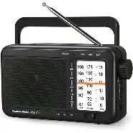

Press Releases How To?
How To Format a Press Release?
For Newspapers or Radio
Guadalupe Radio will help you make Public Service Announcements
📻 Frequency: 1160 kHz AM
⭐ Branding: Radio For Your Soul
Good examples in the Supreme Publication
Public Relations and Publicity 2235

Slide 12

Media

Slide 13
Media
What media do you want to use?
Email
Social media – Facebook, etc.
Council Newsletter
Church Bulletin
U.S. Mail – letters or post cards
Local Newspaper
Catholic Radio
Catholic Newspapers
Council Website
Church Website
Supreme Columbia
Combine the correct media
To cover your target audience
Make Media Contacts!!!
Newspapers, Radio and Public Media

Slide 14
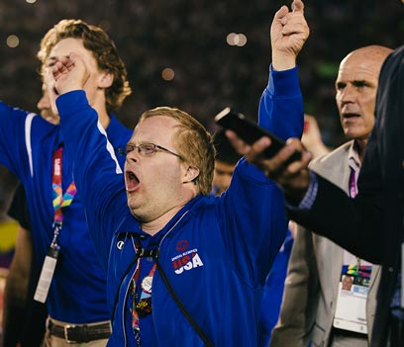
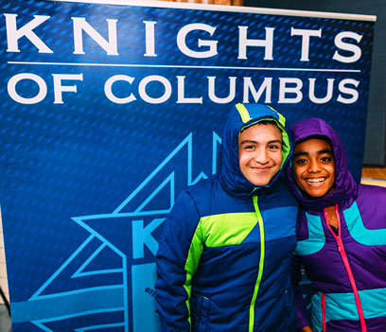
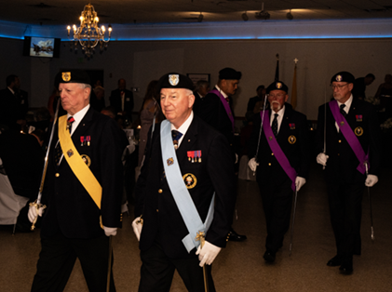
The Power of Photos

Slide 15
The Power of Photos
Elements of a Good Photo
K of C emblems in photos
on a shirt or in background
Smiling people
If appropriate
A good background
Not distracting from the photo
Good lighting
Watch shadows in faces or on emblems
Take some action and posed shots

Slide 16
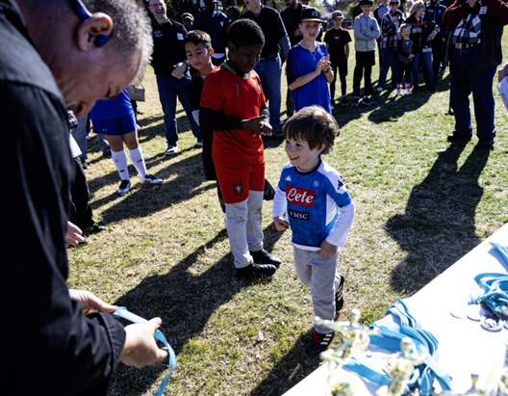
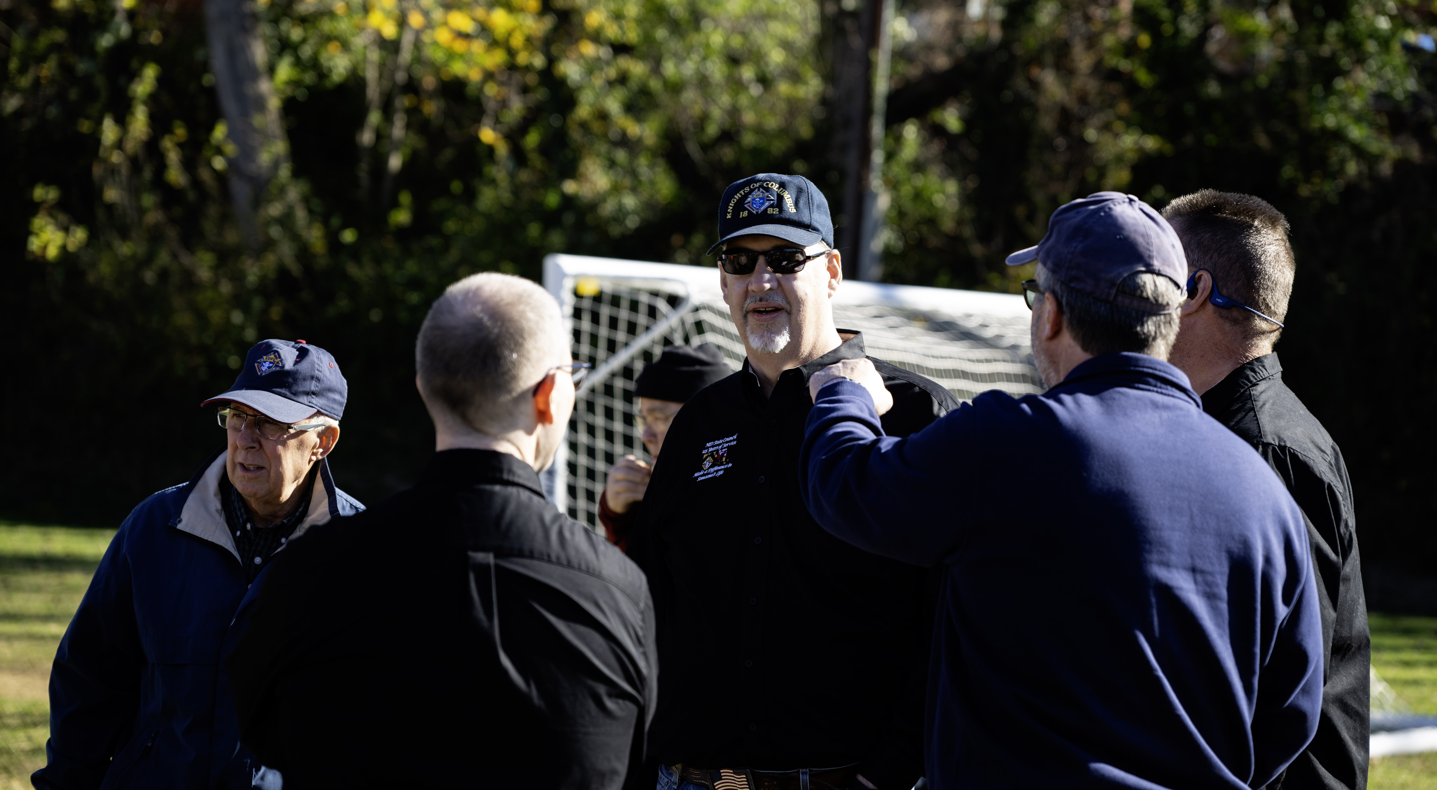
The Power of Photos
For this child, it was a good day
A few good men

Slide 17

Common Problems with Photos
Common problems with photos
Not enough light on the Face
(watch shadows)
Not Smiling
Distracting objects in photo
A Tree or Pole that looks like it coming out of the head
I’ve seen some bad examples of people’s photos

Slide 18
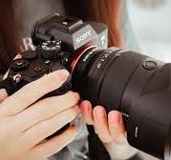
The Power of Photos Camera Gear
Gear
Cell phones work fine most of the time
DSLR or Mirrorless Cameras
Very low light
High contrast
Snow
Bright sunlight
Making Enlargements
Remember
Just use the equipment you have with you

Slide 19
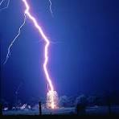
Timing
When to “Bring on the Thunder?”
(Vern Hawkins)

Slide 20

Timing
When should you get the word out?
How many times do we promote it?
When to release an article or promotional
Let’s say your council is getting ready for a membership drive.
It would be good time to send a Press Release about the Council

Slide 21
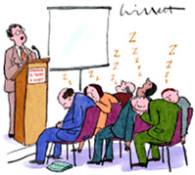
Thanks for Listening

