Slide 1
Planning Your Year
Forms/Audit/Budget
Ron Hassan
State Treasurer

Slide 2
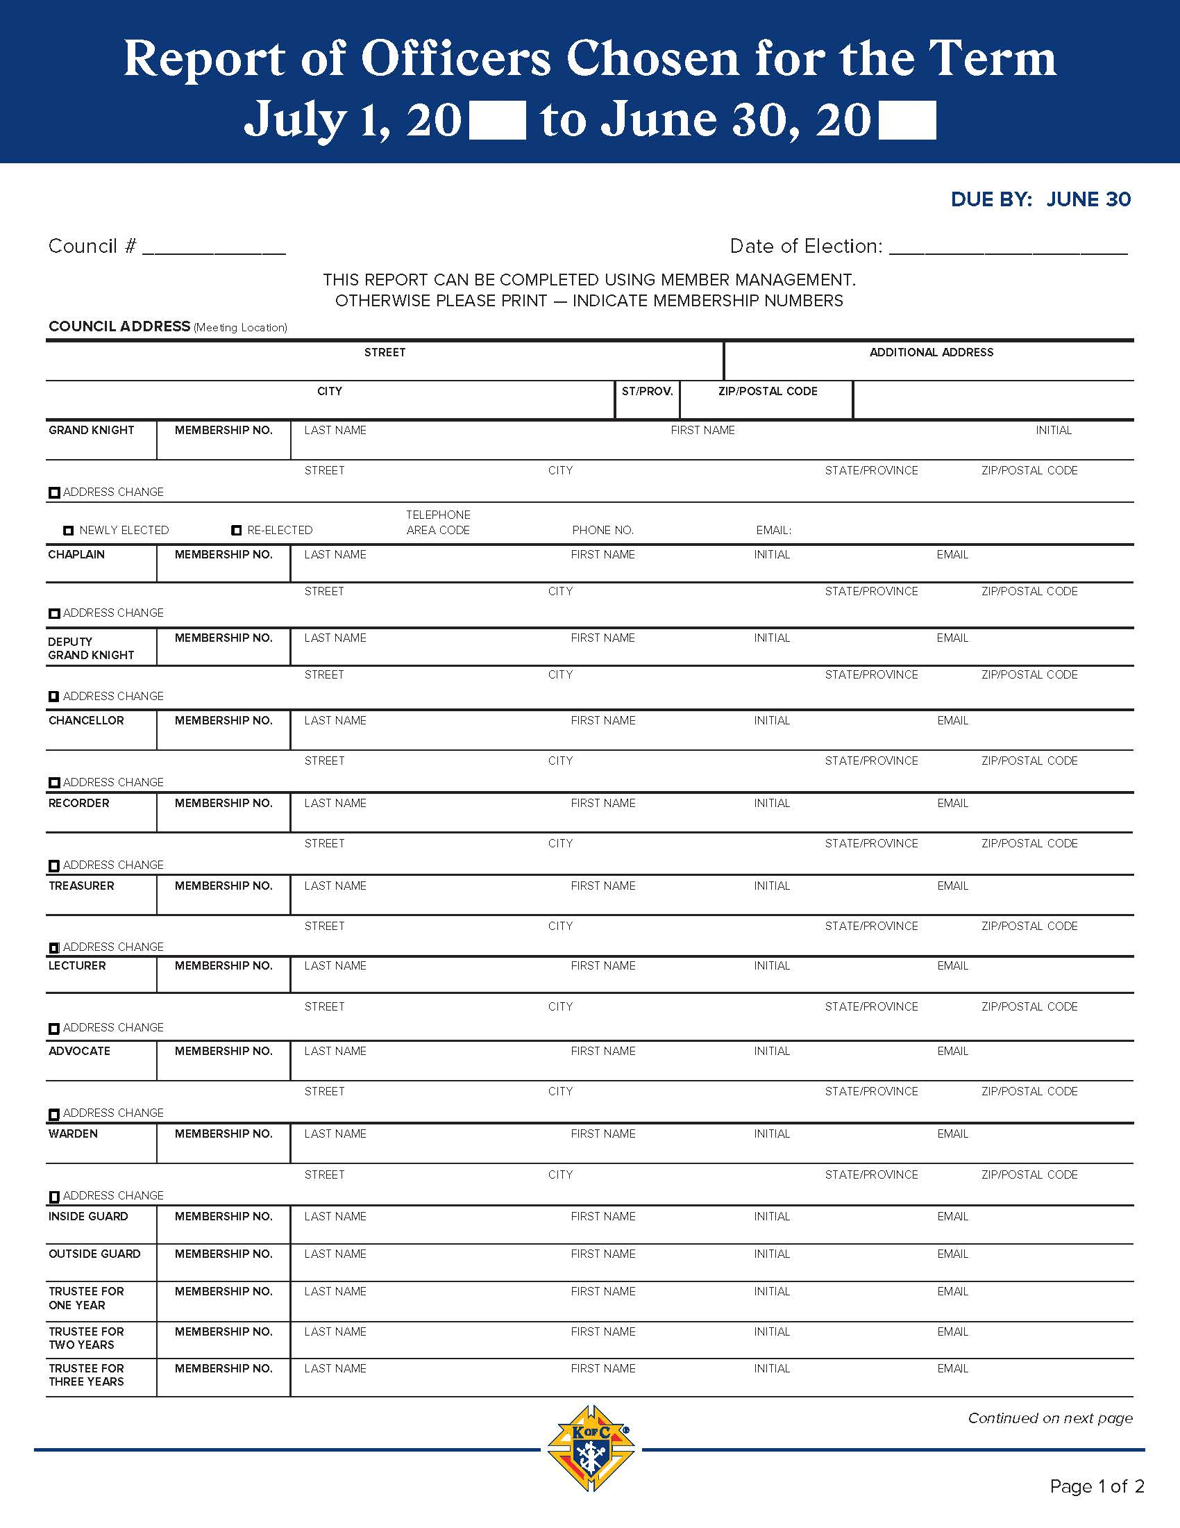
Forms
Form 185 – Report of Officers Chosen
  Notifies Supreme of elected and appointed council officers
  Required for Star Council
  Due July 1
Form 365 – Service Program Personnel Report
  Identifies program directors and chairmen
  Tells Supreme which members are required to complete Safe Environment requirements
  Required for Star Council
  Due July 1

Slide 3
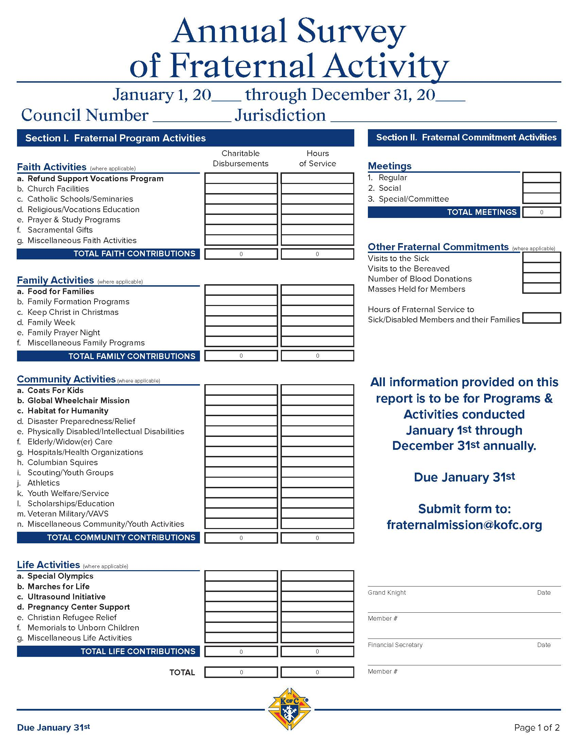
Forms
Form 1295 – Annual Audit
  Internal audit of council finances
  Trustees audit the books of the Treasurer, Financial Secretary, and Recorder
  Signed by Grand Knight and Trustees
  Due August 15
Form 1728 – Annual Survey of Fraternal Activity
  Reports charitable donations, service hours, and volunteer activities to Supreme
  Allows K of C to remain tax exempt
  Required for Star Council
  Due January 31

Slide 4
Forms
SP-7 – Columbian Award Application
  Report of Faith in Action programs of the council
  Required for Star Council
  Due June 30
State Convention Credentials
  Reports the names and ID numbers of the GK, elected Delegate, and first and second alternates
  Emailed by the GK or FS to the State Advocate
  Due by September 1 (but submit as soon as they are elected)

Slide 5
Forms
As needed forms
  Form 10784 – Fraternal Programs Report Form
    At the completion of every Faith in Action program
  Form 10777 – Fraternal Benefits Seminar Form
    Upon completion of FBS to report date and number of participants
  Form 2629 – Report of Appointment of Roundtable Coordinator
  Form 2683 – RSVP and Plaque Application
    Due June 30
Copies of all forms are saved in the council files, sent to the District Deputy and the State Deputy
  State Deputy copy is sent to reports@kofc-md.org

Slide 6
Audit
Internal review of the council finances and financial processes
Conducted by the Trustees and signed by the Trustees and the GK
Requires books of the Treasurer, Financial Secretary, and the Recorder
Submitted to Supreme with a copy to the State Council (reports@kofc-md.org) and the State Treasurer
Conducted annually for the previous fraternal year and due by August 15

Slide 7

Budget
Purpose
  Plans for the council’s finances
  Ensures transparency and continuity
Roles and Responsibilities
  Grand Knight – Provides leadership and vision
  Financial Secretary and Treasurer – Provide historical financial data
  Trustees – Provide oversight
  Council – Gives final approval

Slide 8
Budget
When?
  The budget should be developed and approved in accordance with council policy, but it’s best at the onset of the fraternal year.
How?
  Start with the previous budget
  How did the previous budget perform?
  Identify what activities you plan for the coming year
  Identify expected income and estimate costs for administration, events, and programs
  Adjust as necessary and add new income and expenses

Slide 9

Budget
Income Sources
  Membership Dues
  Planned fundraisers
  Donations & Rebates
  Any carryover funds from previous year

Slide 10

Budget
Budget Categories
  Administration
  Programs (Faith, Family, Community, Life)
  Charitable Contributions
  Events
  Insurance and reserves

Slide 11

Budget
Approval Process
  Council vote required
  Document approval in the meeting minutes
  Budget gives spending authority
Unbudgeted or Over-Budget Expenses
  Requires separate council approval
  Must be documented in the meeting minutes

Slide 12

Questions?

