Slide 1


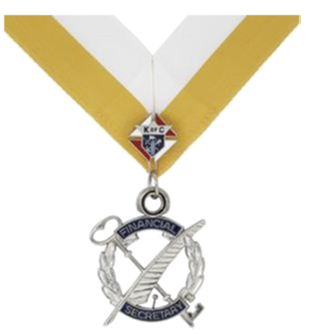
2021 Financial Secretary Training
Documents and Slides Will Be Available At:
https://kofc-md.org/financial-secretary/
We are Servant Leaders

Slide 2
Agenda
Welcome
Opening Prayer
Opening Remarks
Your Responsibilities as Financial Secretary (FS)
FS Processes
FS Resources
Fun With Member Management Data Extract
Closing Prayer
Documents and Slides Available Here:
https://tinyurl.com/2020-FS-Seminar

Slide 3
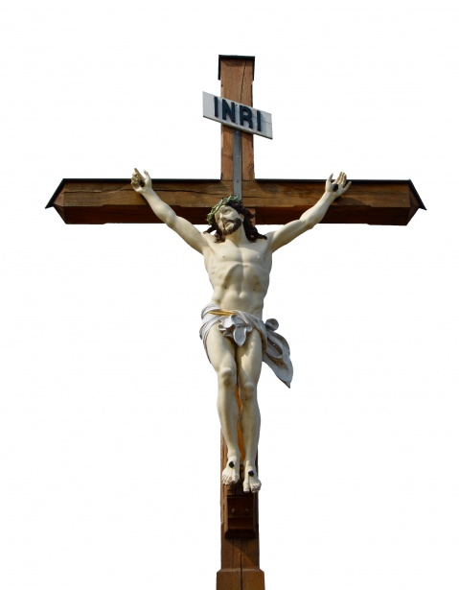
Opening Prayer
Our Father Prayer
Our Father, Who art in heaven,
Hallowed be Thy Name.
Thy Kingdom come.
Thy Will be done,
on earth as it is in Heaven.
Give us this day our daily bread.
And forgive us our trespasses,
as we forgive those who trespass against us.
And lead us not into temptation,
but deliver us from evil. Amen.

Slide 4

Pledge of Allegiance
I pledge allegiance to the Flag of the United States of America, and to the Republic for which it stands, one Nation under God, indivisible, with liberty and justice for all

Slide 5
Overview
Appointment as Financial Secretary is contingent upon
  Being at least 21 years of age and a Third-Degree member
  Not engaged in the sale of life or health insurance for another company
  Not holding another elected position in the council
  Recommended by the Grand Knight and the Trustees, to the Supreme Knight for appointment to a three-year term with the consent of the State Deputy

Slide 6
Financial Secretary Experience
Thank You for your Service

Slide 7
Financial Secretary Timeline
Convention Credentials
9/1/2021
Beginning of Fraternal Year
Form 185 Report of Officers Chosen for Term
7/1/2021
2nd Billing Notice
1/15/2022
Form 1728 Annual Survey of Fraternal Activity
1/31/2022
Council Elections
5/1/2022 - 6/15/2022
Jul
Aug
Sep
Oct
Nov
Dec
Jan
Feb
Mar
Apr
May
Jun
8/1/2021
Form 365 Service Program Personnel Report
8/15/2021
Form 1295-1 Semiannual Council Audit
12/15/2021
1st Billing Notice
4/10/2022
Supreme Per Capita Due
10/10/2021
Supreme Per Capita Due
2/15/2022
Form 1295-2 Semiannual Council Audit
6/30/2022
End of Fraternal Year
Form SP-7 Columbian Award Application
6/30/2022
Form 2630 Annual Report KofC Round Table

Slide 8
Financial Secretary Key Dates

Slide 9
10 Key Responsibilities as FS
Keep an account of member records
Collect and receive all money from any source.
Transfer all moneys received to the Treasurer.
Process dues and membership cards promptly
Provide your records for the audit of your council’s financial books
Causes members to subscribe to by-laws, etc
Promote our Order’s top-rated insurance program
Form good relationships with members in your council, the State Council, and the Supreme Council
Orders supplies from Supplies on Line (no Direct Billing)
Complete and retain copies of Forms

Slide 10
Your Responsibilities as FS
1. Keep an account of member records
  Keep an account of the financial standing of all members.
  The FS is the accountant for the council. Keeps council financial records.
  Constitutional Roll
  Membership Info Examples are:
This includes
  Address
  Phone Numbers
  E-mail
  Dates of degrees
  Spouse
  Parish
  Deaths
It is important to remember that the Financial Secretary of the Council has the ultimate responsibility of maintaining the official record of membership for his council, not Supreme.

Slide 11
Your Responsibilities as FS
Collect and receive all money from any source and keep an accurate accounting of money flow for your council
Dues from members
Fundraisers
Social events
Special collections
    Athletic events
    Any other funds
    Keep an account of the financial standing of all members.
The FS Is the accountant for the council.

Slide 12



  Handling Cash
Reality
Check
1. FS Receives and Records Cash
2. FS Turns Cash Over to Treasurer
5. Treasurer Deposits Cash
3. Treasurer Fills Out Receipt
4. FS Retains Signed Receipt
6. Treasurer Retains Receipt Copy
21st Century Apps

Slide 13
Your Responsibilities as FS
Transfer all moneys received to the Treasurer. Gets receipt from Treasurer
    Dues from members
    Fundraisers
    Contributions or donations
    All other sources
Artifacts for the Council Audit

Slide 14
  Approving Council Bills
1. FS Receives Bill
2. Bill Read At Meeting
5. Voucher Signed By GK & FS
3. Bill Approved By Council
4. FS Prepares Voucher
6. Voucher Given to Treasurer
7. Treasurer Writes Check
8. Treasurer and GK Sign Check
Per Supreme Bylaws, Two Signatures Required.
Bills that can be paid without council approval:
Supreme per capita which includes Catholic Advertising
Supply invoices from Supreme
State per capita and assessments
Budgeted expense items pre-approved by majority of council membership at a regular business meeting.
Sec #122 of Supreme By-Laws limits no more than $500 can be paid or transferred with vote with written notice.

Slide 15
Your Responsibilities as FS
Process dues and membership cards promptly
  Approximate Dates for Billing Dues
    First billing - December 15th
    Second billing - January 15th
    Submit Delinquent member list to Grand Knight – February 15th
    If directed, send Knight Alert – by March 15th
    Upon receiving member dues
      Receipt dues received
      Membership Cards should be embossed with Council Seal

Slide 16
Your Responsibilities as FS
Provide your records for the audit of your council’s financial books
Causes members to subscribe to by-laws, etc
Promote our Order’s top-rated insurance program
Form good relationships with members in your council, the State Council, and the Supreme Council
Orders supplies from Supplies on Line
Complete and retain copies of Forms
Change: No Longer accepts Direct Billing

Slide 17
On-Line Forms
On-Line Forms are your Friend!
  There is a big difference between downloading a form and filling vs on-line forms
Forms typically go to three recipients
  Supreme Address (if not electronic)
  Peter O’Sullivan MD State Forms Manager LNFPRO@comcast.net
  Your District Deputy
  NEVER SEND FORMS TO STATE DEPUTY unless by specific request.
Must save a copy and email to:
State Treasurer should receive a copy of Audit

Slide 18


Slide 19




ROUND
Score Multiplier:
(type only 1, 2, or 3)
1
0
Forms that are the FS Responsibility
1
5
Form 185 Report of Officers Chosen for Term
40
Form 1295-1 Semiannual Council Audit
3
2
6
0
Form 365 Service Program Personnel Report
30
Form 2630 Annual Report KoC Round Table
1
»
0
TEAM 1
«
TEAM 2
3
7
Form 1728 Annual Survey of Fraternal Activity
20
Convention Credentials
1
ADD ROUND POINTS
ADD ROUND POINTS
4
Form SP-7 Columbian Award Application
5
Round:
Blink!
BACK TO SCORES
SHOW QUESTION
TIMER: 10
0
NEXT ROUND
X
X
XX
XXX

Slide 20
Processes
Member Management
Electronic Form 100 Membership (Candidate Tab)
E-Membership (Prospect Tab)
Suspensions
Withdrawals
Taxes

Slide 21
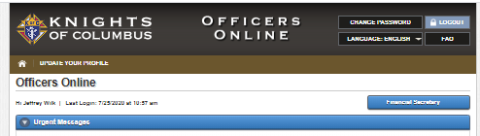
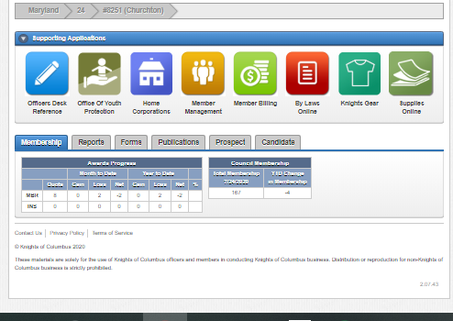
Member Management
Submit Form 100
Update Membership Data
Record Member Deaths
Print Dues Cards
Document Dues Receipts
Order Supplies
Get Various Reports

Slide 22
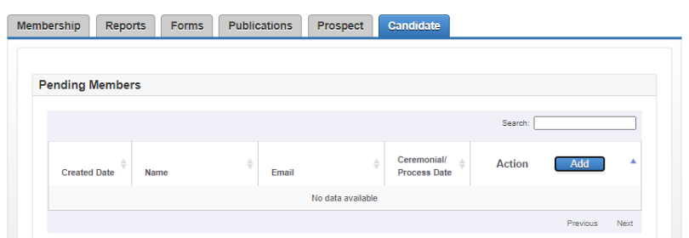
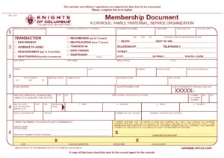
Electronic Form 100 Membership
Used to submit Form 100 for Adds and Transfers.
Does not require any signature.
Hit the Add Button, and drop down appears to add member info
  You will need name, addr, phone, email, bday
Once member takes his Exemplification, fill in Ceremonial date and hit add.

Slide 23
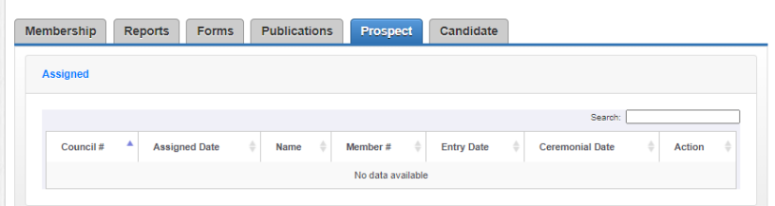
Electronic Form 100 Membership
Once a member joins Online, the State E-Membership Director will add them to your Prospect list.
Reach out to the Prospect to have him take his Exemplification (Online or in Person)
Hit the Add Button, and drop down appears to add member info

Slide 24
Cases that warrant special review:
  Suspensions
Member has financial difficulty and unable to pay dues. The Grand Knight can waive or partially waive dues, but this does not relieve the council from paying per capita.
If member has medical problems which deter his ability to earn income or if totally disabled, then submit completed Form #1831.
Do not suspend anyone who is three or less years in arrears.
Do not suspend anyone who is within two years of reaching Honorary Life status.
If you absolutely must suspend someone have your Council’s Growth Chairman be prepared to replace him with two new members.
If you have five or more suspensions, please spread them out over a few months.

Slide 25
  Withdrawal Process
Member must send a personal letter (or an email), signed by him and mailed to the council or Membership Records. The council forwards this document if applicable. Requires a paper (or scanned version) Form 100

Slide 26
  Federal Income Tax
The Knights of Columbus is organized under IRS code (501) (c)(8), a fraternal benefits society.
  Councils are exempt from federal income tax.
  Must provide EIN number to Supreme Advocate.
  Solicitations are not deductible for tax purposes.
  When filing for the first time do not use the words Supreme council, use Knights of Columbus and council name.

Slide 27
  Federal Income Tax
Federal Income Tax Information – Form 990
ALL councils must file one of the following:
  990N - Gross receipts not exceeding $50,000
  (electronically only, available at www.irs.gov)
  990EZ – Gross receipts over $50,000 and up to $199,999
  990 – Gross receipts over $200,000
Must file by the15th day of the 5th month after the end of your organization's accounting period. (If filing by fraternal year, form is due by Nov 15th)
Group Exemption number for 990 & 990EZ is 0188
Failure to file 3 consecutive years will result in a loss of tax exempt status!

Slide 28
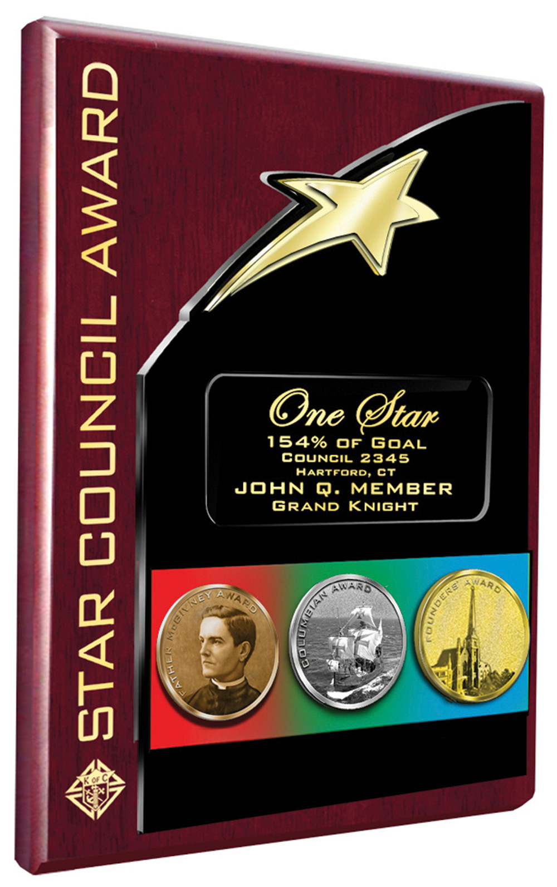
  Star Council Award
Program Personnel Reported
Form #365 Due by August 1
Membership
Quota = 3 or 5% net increase in membership
(min 3 or max or 23)
Fraternal Survey
Form #1728 Due by Jan 31st
Columbian Award
SP-7 Due by June 30th

Slide 29
Financial Secretary Timeline
Convention Credentials
9/1/2021
Beginning of Fraternal Year
Form 185 Report of Officers Chosen for Term
7/1/2021
2nd Billing Notice
1/15/2022
Form 1728 Annual Survey of Fraternal Activity
1/31/2022
Council Elections
5/1/2022 - 6/15/2022
Jul
Aug
Sep
Oct
Nov
Dec
Jan
Feb
Mar
Apr
May
Jun
8/1/2021
Form 365 Service Program Personnel Report
8/15/2021
Form 1295-1 Semiannual Council Audit
12/15/2021
1st Billing Notice
4/10/2022
Supreme Per Capita Due
10/10/2021
Supreme Per Capita Due
2/15/2022
Form 1295-2 Semiannual Council Audit
6/30/2022
End of Fraternal Year
Form SP-7 Columbian Award Application
6/30/2022
Form 2630 Annual Report KofC Round Table

Slide 30
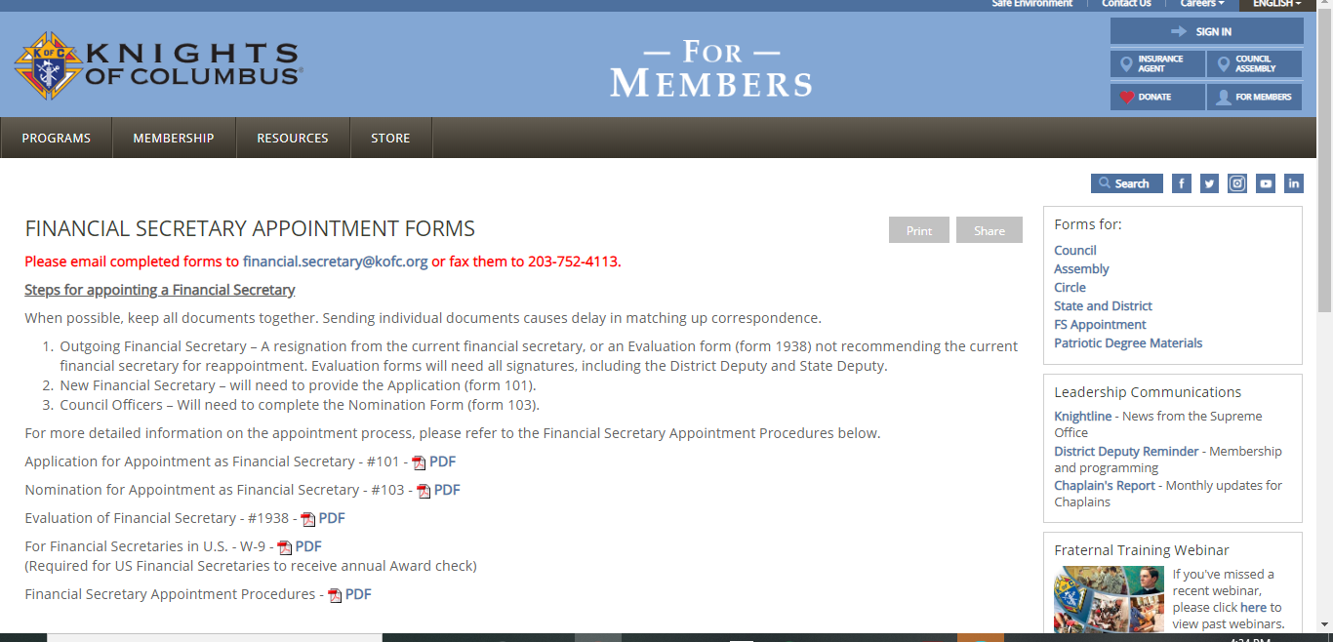
Resources
Financial Secretary Appointment Forms
http://www.kofc.org/en/members/resources/forms/fs-appt.html
Please email completed forms to financial.secretary@kofc.org
or fax them to 203-752-4103.
FS Appointments should be coordinated with your DD and the State Deputy

Slide 31
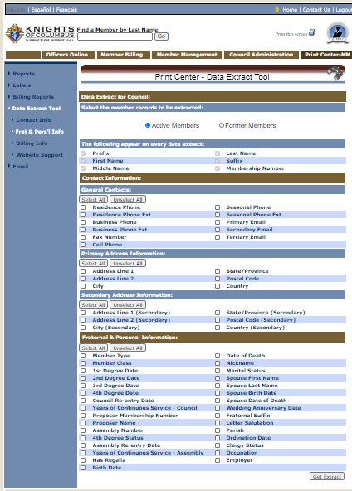
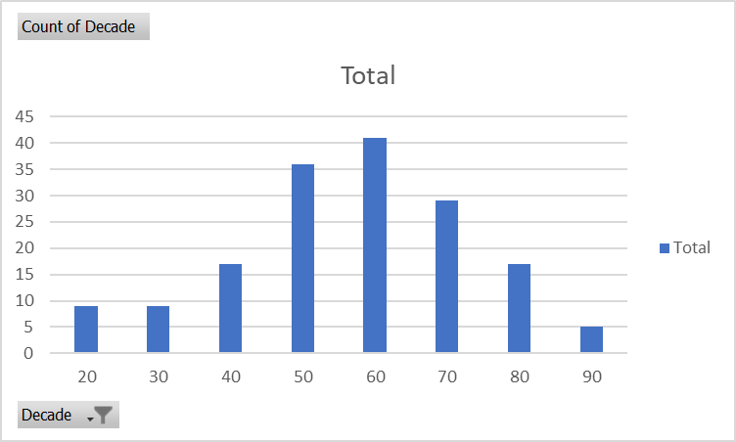

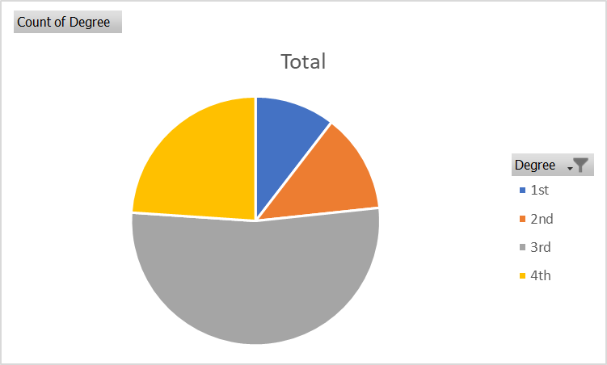
  Print Center
Excel Formula to Calculate Decade =ROUNDDOWN((YEAR(TODAY())-YEAR(AV2))/10,0)*10
Excel Formula to Calculate Degree =IF(AL3<>"","4th",IF(AK3<>"","3rd",(IF(AJ3<>"","2nd","1st"))))

Slide 32
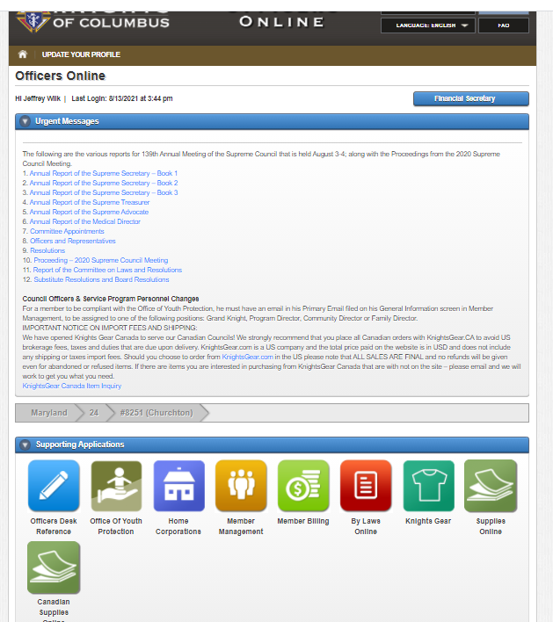
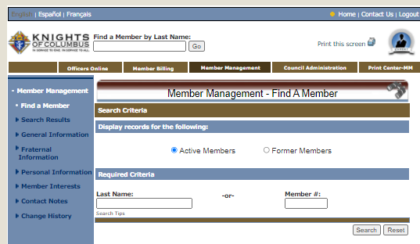
  Fun With Excel & Member Mgmt
Log into www.kofc.org with FS Account
Goto Member Management
Goto Print Center

Slide 33
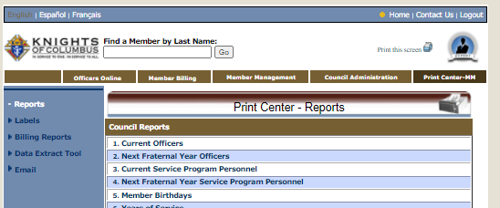
  Fun With Excel & Member Mgmt
Select Extract Tool
Goto Print Center

Slide 34
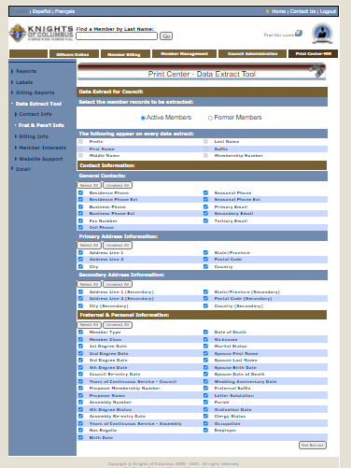
  Fun With Excel & Member Mgmt
Select All Fields
Get Extract

Slide 35
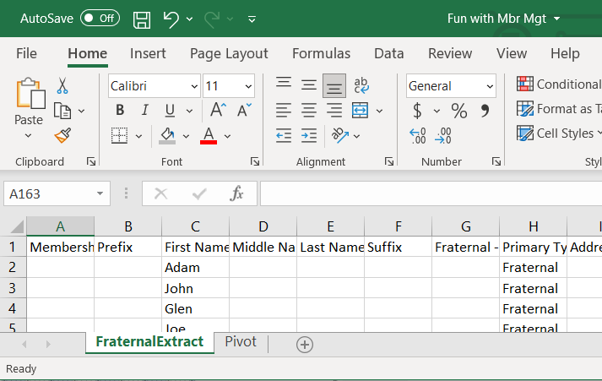
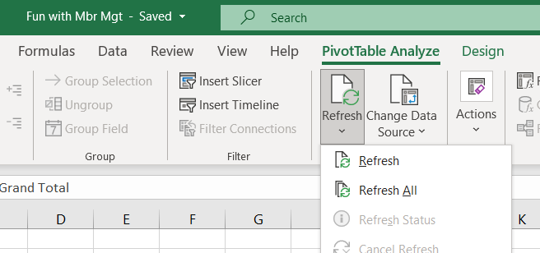
  Fun With Excel & Member Mgmt
This will create a file named FraternalExtract.csv
  This will have your Council Information.
  Open the template file Fun with Mbr Mgt.xls
  Goto file named FraternalExtract.csv copy columns A:BK to the Fun with Mbr Mgt.xls
  Goto Pivot Tab
  Refresh Data
  Refresh All

Slide 36

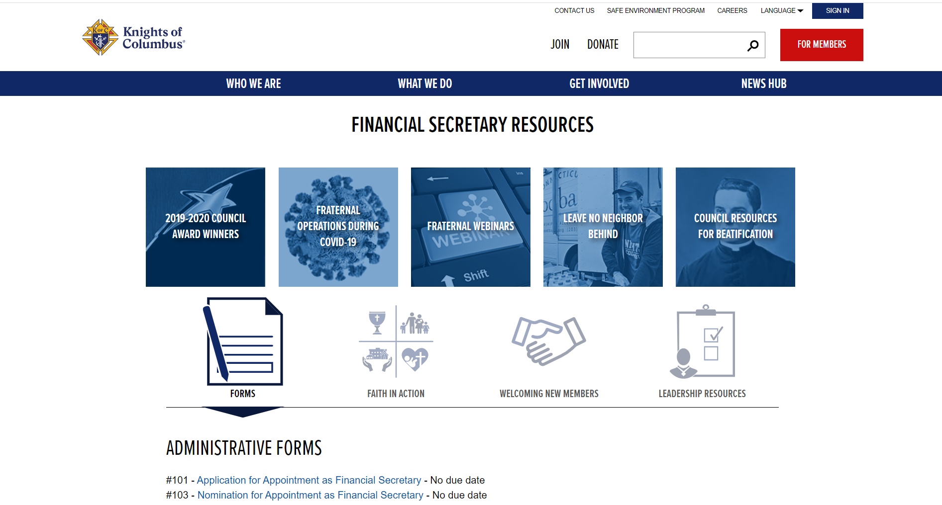
  Resources
Financial Secretary's Guide
https://www.kofc.org/un/en/forms/leadership/financial-secretary5089.pdf
Leadership Resources Updated https://www.kofc.org/un/en/resources/officers/officers.pdf
Laws of Order
https://www.kofc.org/en/forms/leadership/charter-const-laws30.pdf
KoC Online Financial Secretary Resources
https://www.kofc.org/en/for-members/resources/council-leaders/financial-secretary.html

Slide 37
Useful Email Addresses to Know
Email Address | Purpose
membershiprecords@kofc.org | Membership Forms Processing Membership Information Updates Form 185 - Officers Chosen For Term
generaloffice@kofc.org | State Deputy Appointments, Executive Secretary Appointments, District Deputy Appointments, Expense Reports
councilaccounts@kofc.org | Council Account Balances Semi Annual Audit Report (#1295)
financial.secretary@kofc.org | Financial Secretary Appointments & Inquiries
fraternalmission@kofc.org | General Inquiries, Programs, Council Awards, Annual Survey of Fraternal Activity, Columbian Award, Fraternal forms Submissions, Form 365 Service Program Personnel Report (state and council).
fraternaltraining@kofc.org | Fraternal Training Inquiries & Training Webinars
squires@kofc.org | Squires & Circles Related Inquires
LNFPRO@comcast.net | MD State Forms Manager, Peter O'Sullivan
diwilk@wilkworld.net | MD State FS Advisor

Slide 38
Financial Secretary Timeline
Convention Credentials
9/1/2021
Beginning of Fraternal Year
Form 185 Report of Officers Chosen for Term
7/1/2021
2nd Billing Notice
1/15/2022
Form 1728 Annual Survey of Fraternal Activity
1/31/2022
Council Elections
5/1/2022 - 6/15/2022
Jul
Aug
Sep
Oct
Nov
Dec
Jan
Feb
Mar
Apr
May
Jun
8/1/2021
Form 365 Service Program Personnel Report
8/15/2021
Form 1295-1 Semiannual Council Audit
12/15/2021
1st Billing Notice
4/10/2022
Supreme Per Capita Due
10/10/2021
Supreme Per Capita Due
2/15/2022
Form 1295-2 Semiannual Council Audit
6/30/2022
End of Fraternal Year
Form SP-7 Columbian Award Application
6/30/2022
Form 2630 Annual Report KofC Round Table

Slide 39
Contact Info
Contact Info:
Jeffrey Wilk, FDD, PGK. PFN
diwilk@wilkworld.net
410-533-1811
  Slides and Video of the Seminar will be available on State KofC Website
  https://kofc-md.org/financial-secretary/

Slide 40
Closing Prayer
Prayer for the Canonization of Father Michael J. McGivney
  God, our Father, protector of the poor and defender of the widow and orphan, you called your priest, Blessed Michael McGivney, to be an apostle of Christian family life and to lead the young to the generous service of their neighbor. Through the example of his life and virtue, may we follow your Son, Jesus Christ, more closely, fulfilling his commandment of charity and building up his Body which is the Church. Let the inspiration of your servant prompt us to greater confidence in your love so that we may continue his work of caring for the needy and the outcast. We humbly ask that you glorify Blessed Michael McGivney on earth according to the design of your holy will. Through his intercession, grant the favor I now present (here make your request). Through Christ our Lord. Amen.

