Slide 1


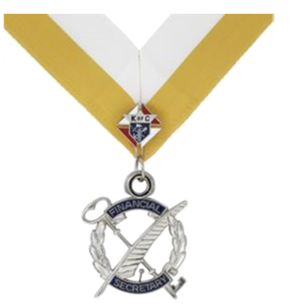
Financial Secretary Training
We are Servant Leaders

Slide 2
Agenda
Welcome
Opening Prayer
Your Responsibilities as Financial Secretary (FS)
Forms Jeopardy
FS Procedures
FS Resources
Closing Prayer
Documents and Slides Available Here:
https://kofc-md.org/financial-secretary/

Slide 3
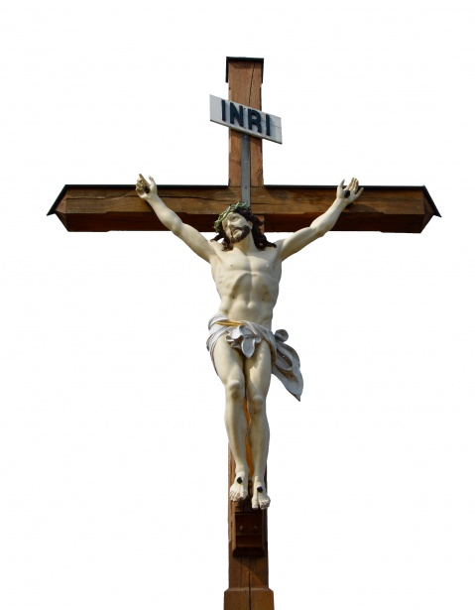
Opening Prayer
Our Father Prayer
Our Father, Who art in heaven,
Hallowed be Thy Name.
Thy Kingdom come.
Thy Will be done,
on earth as it is in Heaven.
Give us this day our daily bread.
And forgive us our trespasses,
as we forgive those who trespass against us.
And lead us not into temptation,
but deliver us from evil. Amen.

Slide 4

Pledge of Allegiance
I pledge allegiance to the Flag of the United States of America, and to the Republic for which it stands, one Nation under God, indivisible, with liberty and justice for all

Slide 5
Agenda
Welcome
Opening Prayer
Your Responsibilities as Financial Secretary (FS)
Forms Jeopardy
FS Procedures
FS Resources
Closing Prayer
Documents and Slides Available Here:
https://kofc-md.org/financial-secretary/

Slide 6
Overview
Appointment as Financial Secretary is contingent upon
  Being at least 21 years of age and a Third Degree member
  Not being engaged in the sale of life or health insurance for another company
  Not holding another elected position in the council
  Recommended by the Grand Knight and the Trustees, to the Supreme Knight for appointment to a three-year term with the consent of the State Deputy

Slide 7
Financial Secretary Timeline
8/1
Form 365 Service Program Personnel Report
1/31
Form 1728 Annual Survey of Fraternal Activity
5/1 -------------- 6/15
Council Elections
7/1
Beginning of Fraternal Year
9/1
Convention Credentials
4/10
Supreme Per Capita Due
6/30
End of Fraternal Year
12/15
1st Billing Notice
7/1
Form 185 Report of Officers Chosen for Term
1/15
2nd Billing Notice
10/10
Supreme Per Capita Due
6/30
Form SP-7 Columbian Award Application
2/15
Form 1295-2 Semiannual Council Audit
8/15
Form 1295-1 Semiannual Council Audit
6/30
Form 2630 Annual Report KofC Round Table

Slide 8
Your Responsibilities as FS
1. Keep an account of member records
  Keep an account of the financial standing of all members.
  The FS is the accountant for the council. Keeps council financial records.
It is important to remember that the Financial Secretary of the Council has the ultimate responsibility of maintaining the official record of membership for his council, not Supreme.
This includes
  Address
  Phone Numbers
  E-mail
  Dates of degrees
  Spouse
  Parish
  Deaths

Slide 9
Your Responsibilities as FS
Collect and receive all money from any source and keep an accurate accounting of money flow for your council
    Dues from members
    Fundraisers
    Social events
    Special collections
    Athletic events
    Any other funds
    Keep an account of the financial standing of all members.
The FS Is the accountant for the council.

Slide 10
Your Responsibilities as FS
Transfer all moneys received to the Treasurer. Gets receipt from Treasurer
    Dues from members
    Fundraisers
    Contributions or donations
    All other sources
These Receipts are used in Council Audit

Slide 11
Your Responsibilities as FS
Process dues and membership cards promptly
Provide your records for the audit of your council’s financial books
Causes members to subscribe to by-laws, etc
Promote our Order’s top-rated insurance program
Form good relationships with members in your council, the State Council, and the Supreme Council
Orders supplies from Supplies on Line
Complete and retain copies of Forms

Slide 12


Forms

Slide 13

Mandatory
Forms
Overlooked
Forms
Potpourri
100
100
100
200
200
200
300
300
300

Slide 14
Notifies Supreme of Officers Chosen

Slide 15

Form 185 Report of Officers Chosen for Term
Highly recommend you use the Online Form

Slide 16
Form 365

Slide 17
Service Personnel Chosen
Triggers SAFE Training and Supreme Communications

Slide 18
Used by Supreme to Keep Tax Exempt Status
Documents Service Hours of Council

Slide 19
Form 1728 Annual Survey of Fraternal Activity
Hint: Request Service Hours when sending out 1st Dues Notices.
Offer an incentive.
.
Often under estimated

Slide 20
Form 2630

Slide 21
Annual Report KofC Round Table
You should file this form even if your Council only supports one Parish

Slide 22
Documents Special Olympics Support

Slide 23
Form 4584 Partnership Profile Report with Special Olympics

Slide 24
Required to Receive Your Rebate

Slide 25
Form 2863 RSVP and Plaque Application or
Form 10057 Food For Families Report Form

Slide 26
Fail to File Can Cause a Council to be Suspended

Slide 27
Form 1295-1 Semiannual Council Audit (due August 15)
Form 1295-2 Semiannual Council Audit (due February 15)
Requires “Real” Signatures

Slide 28
Not a KofC Form, Form 990N or Form 990EZ

Slide 29
Federal Income Tax
Must file by the15th day of the 5th month after the end of your organization's accounting period. (If filing by fraternal year, form is due by Nov 15th)

Slide 30
Not an Official Form, But is Required to be Submitted to State Secretary

Slide 31
Convention Credentials
Requires “Real” Signatures and the must be embossed with Council Stamp

Slide 32


Slide 33
Documents Charitable Activities of the Council

Slide 34
Form SP-7 Columbian Award Application
File early (Mid May) to leave time if there are problems

Slide 35
On-Line Forms
On-Line Forms are your Friend!
  There is a big difference between downloading a form and filling vs on-line forms
Forms typically go to three recipients
  Supreme Address (if not electronic)
  Peter O’Sullivan MD State Forms Manager LNFPRO@comcast.net
  Your District Deputy
  NEVER SEND FORMS TO STATE DEPUTY unless by specific request.

Slide 36
Forms Summary
Forms | Due Date
Form 4584 Partnership Profile Report with Special Olympics | 1/31
Form 1728 Annual Survey of Fraternal Activity | 1/31
Form 1295-2 Semiannual Council Audit (due February) | 2/15
Form SP-7 Columbian Award Application | 6/30
Form 2863 RSVP and Plaque Application | 6/30
Form 2630 Annual Report KofC Round Table | 6/30
Form 10057 Food For Families Report Form | 6/30
Form 185 Report of Officers Chosen for Term | 7/1
Form 365 Service Program Personnel Report | 8/1
Form 1295-1 Semiannual Council Audit (due August) | 8/15
Convention Credentials | 9/1

Slide 37
Financial Secretary Timeline
8/1
Form 365 Service Program Personnel Report
1/31
Form 1728 Annual Survey of Fraternal Activity
7/1
Beginning of Fraternal Year
9/1
Convention Credentials
6/30
End of Fraternal Year
7/1
Form 185 Report of Officers Chosen for Term
6/30
Form SP-7 Columbian Award Application
2/15
Form 1295-2 Semiannual Council Audit
8/15
Form 1295-1 Semiannual Council Audit
6/30
Form 2630 Annual Report KofC Round Table

Slide 38
Processes
Electronic Form 100 Membership (Candidate Tab)
E-Membership (Prospect Tab)
Handling Cash
Approving Council Bills
Member Billing
Suspensions
Withdrawals

Slide 39
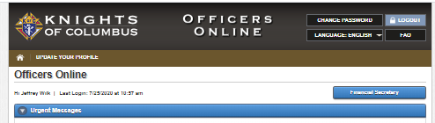
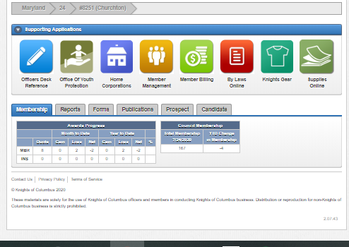
Processes – Member Management
Submit Form 100
Update Membership Data
Record Member Deaths
Print Dues Cards
Document Dues Receipts
Get forms
Order Supplies
Email Membership
Get Various Reports

Slide 40
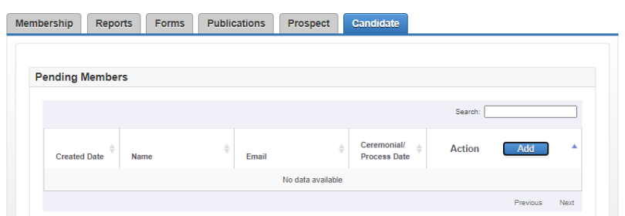
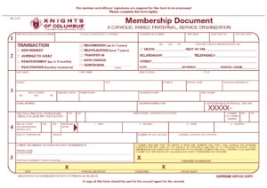
Electronic Form 100 Membership
Used to submit Form 100 for Adds and Transfers.
Does not require any signature.
Hit the Add Button, and drop down appears to add member info
Once member takes his Exemplification, fill in Ceremonial date and hit add.

Slide 41
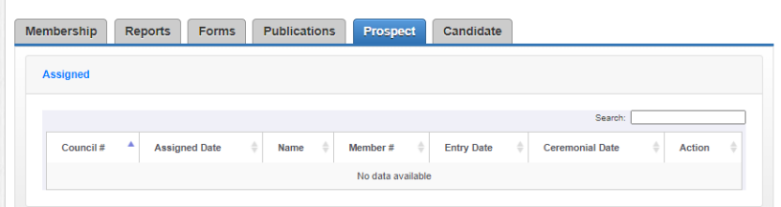
Electronic Form 100 Membership
Once a member joins Online, the State E-Membership Director will add them to your Prospect list.
Reach out to the Prospect to have him take his Exemplification (Online or in Person)
Hit the Add Button, and drop down appears to add member info

Slide 42

  Handling Cash
FS Receives and Records Cash
FS Turns Cash Over to Treasurer
Treasurer Fills Out Receipt
FS Retains Signed Receipt
Treasurer Deposits Cash
Treasurer Retains Receipt Copy

Slide 43
FS Receives Bill
Bill Read At Meeting
Bill Approved By Council
FS Prepares Voucher
  Approving Council Bills
Voucher Signed By GK & FS
Voucher Given to Treasurer
Treasurer Writes Check
Treasurer and GK Sign Check
Per Supreme Bylaws, Two Signatures Required. The State will check!

Slide 44
  Approving Council Bills
Bills that can be paid without council approval:
  Supreme per capita which includes Catholic Advertising
  Supply invoices from Supreme
  State per capita and assessments
  Budgeted expense items pre-approved by majority of council membership at a regular business meeting.

Slide 45
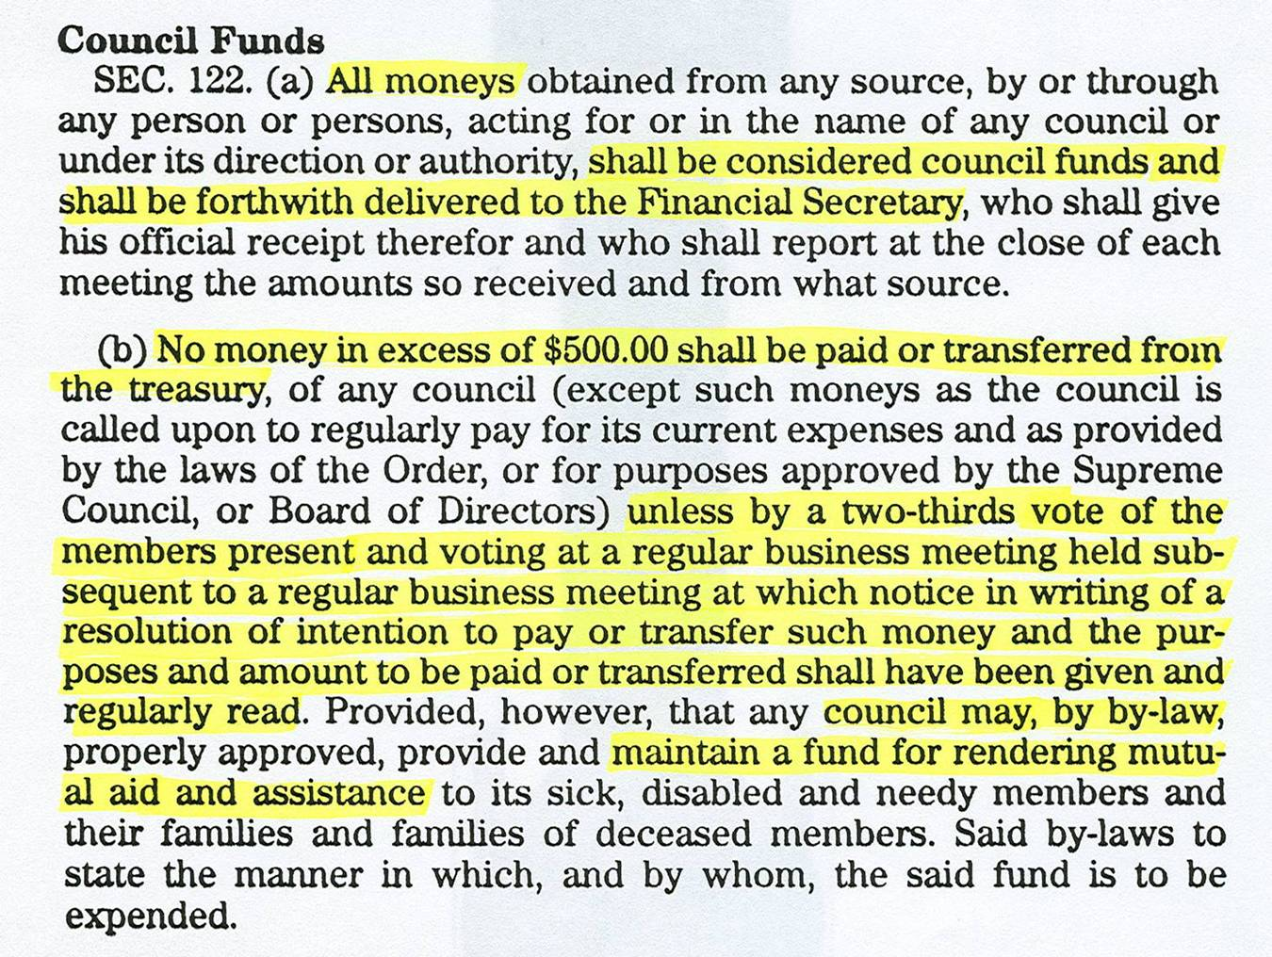
  Approving Council Bills
Sec #122 of Supreme By-Laws limits amount a Council can pay or transfer.

Slide 46
  Member Billing
Approximate Dates, when using Calendar Year for Billing Dues
  First billing - December 15th
  Second billing - January 15th
  Submit Delinquent member list to Grand Knight – February 15th
  If directed, send Knight Alert – by March 15th

Slide 47
  Suspensions
When a member has not paid dues 30 days after he has been sent the Second Notice or about February 15th , someone from the retention committee should ideally make a personal visit to the member to explain benefits of membership and determine the reason for the delay in dues payment.
If a personal visit isn’t feasible, other contact methods should be used.
Results of this contact should be thoroughly documented.

Slide 48
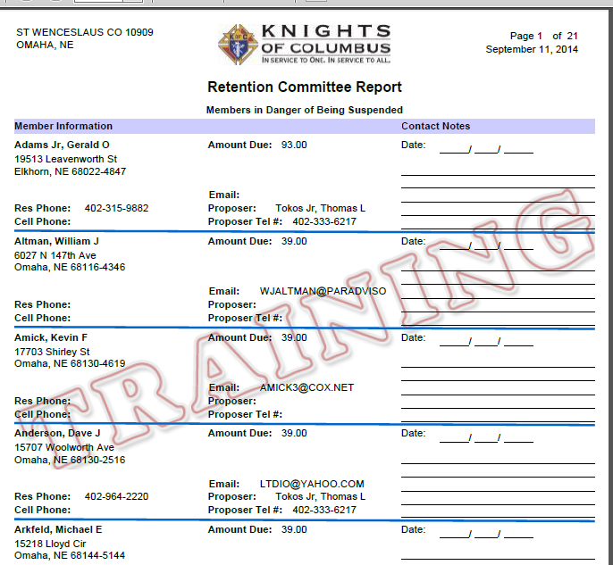
  Suspensions
Example of Retention Report – Member Management
Report from Member Management – Print Center – Billing Reports -Retention

Slide 49
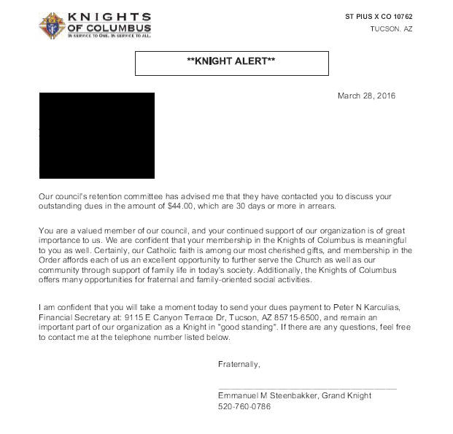
  Suspensions
KNIGHT ALERT (available in Member Billing – print section)
After second contact or attempted contact, all members that have not paid should be reported to the Grand Knight and Retention Committee. Retention Committee could include the GK, DGK, Trustees, Retention Chairman and Field Agent .
Grand Knight sends the delinquent member a copy of this form informing of their possible suspension from the Order if their dues are not paid.
.

Slide 50
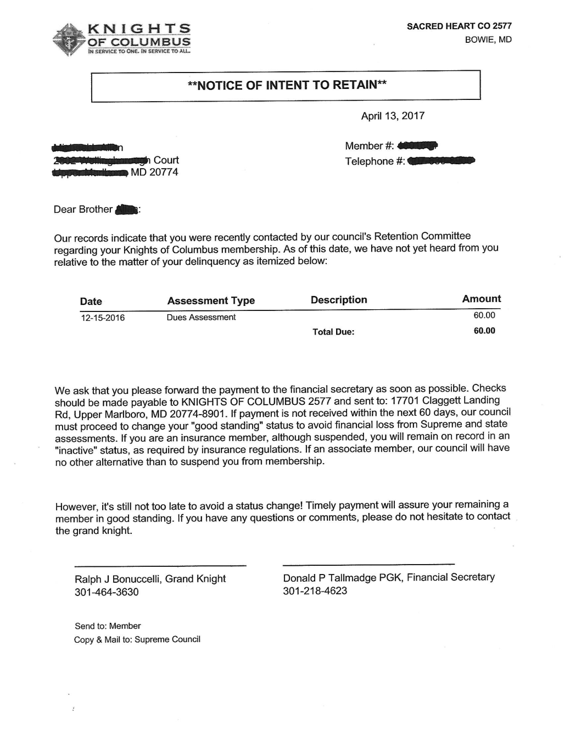
  Suspensions
NOTICE OF INTENT TO RETAIN (available in Member Billing – print section)
If the member has not paid his dues within about 15 days after the Knight Alert had been received, a Notice of Intent to Retain will be prepared.

Slide 51
  Suspensions
Billing Process-Suspension Form #1845-Notice of Intent to Retain
Mail original copy to delinquent member
Mail copy to Supreme Membership Records. Supreme Knight then and to the member.
State Deputy Gets Conservation Report and may gives advice
District Deputy Gets Conservation Report and contacts the member.
Council retains council copy

Slide 52
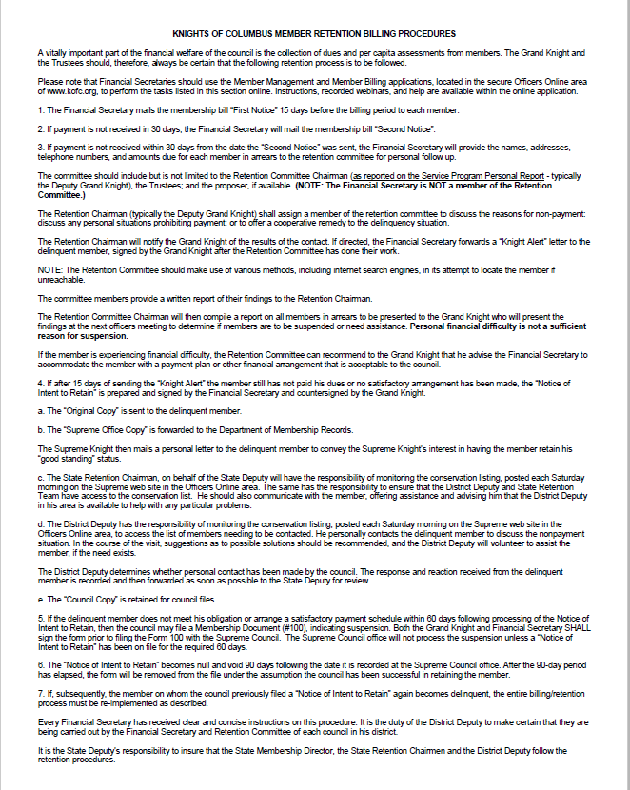
  Suspensions
Billing Process in Detail

Slide 53
Cases that warrant special review:
  Suspensions
Member has financial difficulty and unable to pay dues. The Grand Knight can waive or partially waive dues, but this does not relieve the council from paying per capita.
If member has medical problems which deter his ability to earn income or if totally disabled, then submit completed Form #1831.
Do not suspend anyone who is three or less years in arrears.
Do not suspend anyone who is within two years of reaching Honorary Life status.
If you absolutely must suspend someone have your Council’s Growth Chairman be prepared to replace him with two new members.
If you have five or more suspensions please spread them out over a few months.

Slide 54
  Suspensions
Other Suspension Actions
Suspension-Failure to remain Catholic.
  Requires letter from member or pastor attesting to this fact.
Suspension-Felony conviction.
  Requires newspaper account of conviction or court documentation
Suspension-Misconduct.
  For violating the Order’s laws

Slide 55
  Withdrawal Process
Member must send a personal letter (or an email), signed by him and mailed to the council or Membership Records. The council forwards this document if applicable. Requires a paper (or scanned version) Form 100

Slide 56
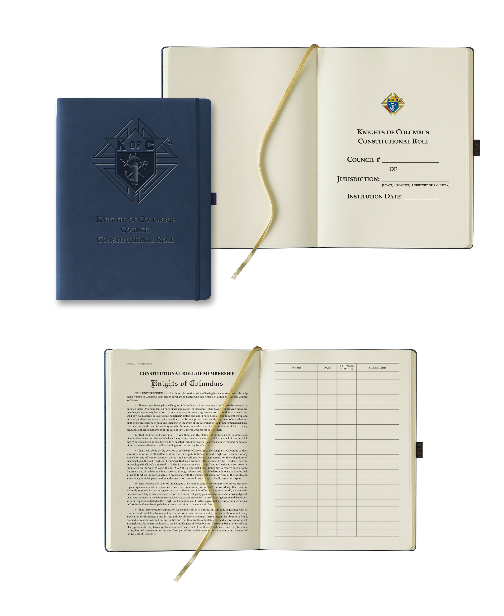
  Miscellaneous Processes
Keep a record of ceremonial books & maintain Constitutional Role
Order supplies as needed or requested by Grand Knight.
Provide Field Agent with assistance
  Supreme has come out with new Constitutional Role
  The updated Constitutional Roll is now available for order at Supplies Online, and can be ordered by councils for $10.96 USD each. Enter “Constitutional Roll” or item number 343 in the search bar.

Slide 57
  Federal Income Tax
The Knights of Columbus is organized under IRS code (501) (c)(8), a fraternal benefits society.
  Councils are exempt from federal income tax.
  Must provide EIN number to Supreme Advocate.
  Solicitations are not deductible for tax purposes.
  When filing for the first time do not use the words Supreme council, use Knights of Columbus and council name.

Slide 58
  Federal Income Tax
Federal Income Tax Information – Form 990
ALL councils must file one of the following:
  990N - Gross receipts not exceeding $50,000
  (electronically only, available at www.irs.gov)
  990EZ – Gross receipts over $50,000 and up to $199,999
  990 – Gross receipts over $200,000
Must file by the15th day of the 5th month after the end of your organization's accounting period. (If filing by fraternal year, form is due by Nov 15th)
Group Exemption number for 990 & 990EZ is 0188
Failure to file 3 consecutive years will result in a loss of tax exempt status!

Slide 59
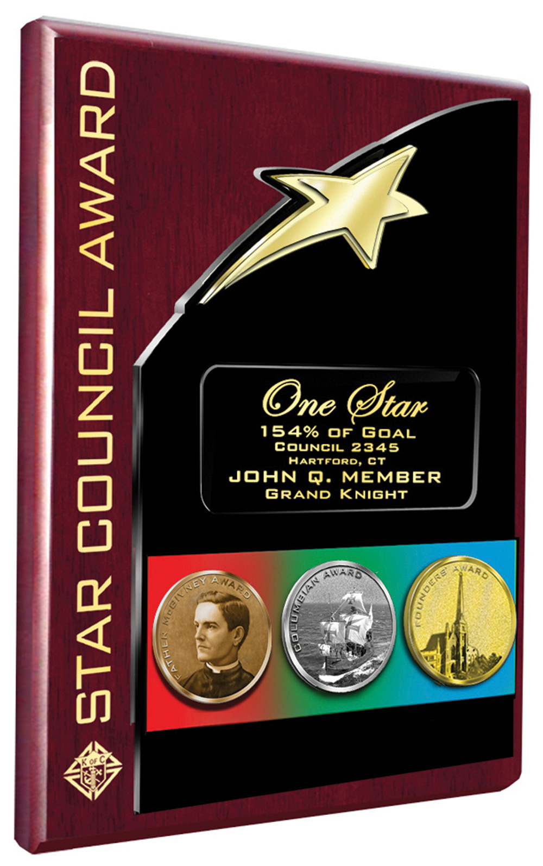
  Star Council Award
Program Personnel Reported
Form #365 Due by August 1
Membership
Quota = 3 or 5% net increase in membership (minimum of 3or mx or 23)
Fraternal Survey
Form #1728 Due by Jan 31st
Columbian Award
SP-7 Due by June 30th

Slide 60
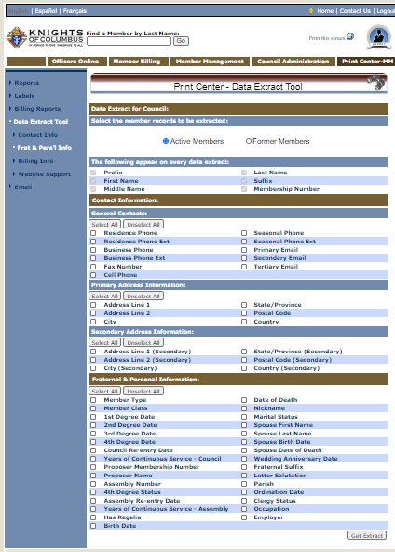

  Print Center
Excel Formula to Calculate Decade =ROUNDDOWN((YEAR(TODAY())-YEAR(AV2))/10,0)*10

Slide 61
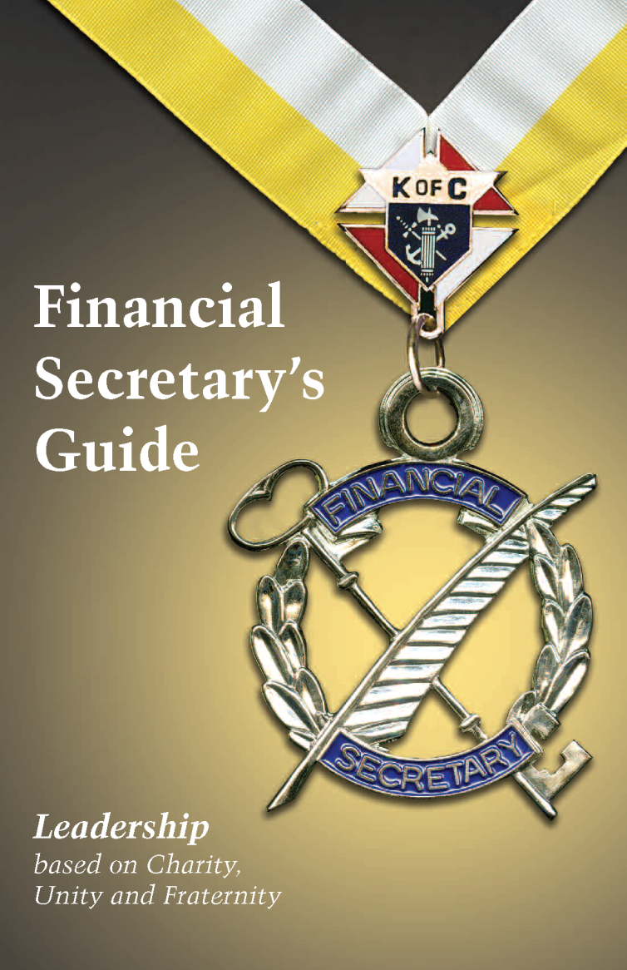

Resources
  Financial Secretary's Guide
  https://www.kofc.org/un/en/forms/leadership/financial-secretary5089.pdf
Leadership Resources Updated https://www.kofc.org/un/en/resources/officers/officers.pdf
  Laws of Order
  https://www.kofc.org/en/forms/leadership/charter-const-laws30.pdf
  Robert’s Rules of Order
  http://www.rulesonline.com/

Slide 62
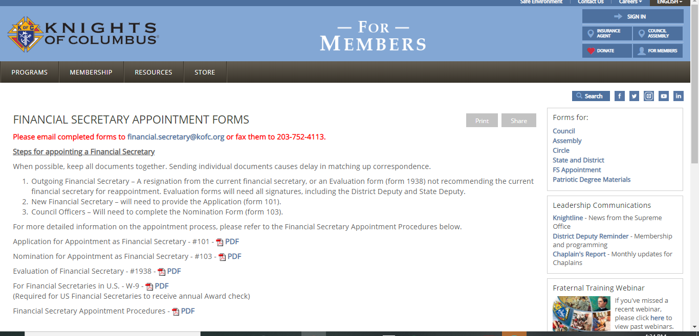
Resources
Financial Secretary Appointment Forms
http://www.kofc.org/en/members/resources/forms/fs-appt.html
Please email completed forms to financial.secretary@kofc.org
or fax them to 203-752-4103.

Slide 63
Financial Secretary Timeline
8/1
Form 365 Service Program Personnel Report
1/31
Form 1728 Annual Survey of Fraternal Activity
5/1 -------------- 6/15
Council Elections
7/1
Beginning of Fraternal Year
9/1
Convention Credentials
4/10
Supreme Per Capita Due
6/30
End of Fraternal Year
12/15
1st Billing Notice
7/1
Form 185 Report of Officers Chosen for Term
1/15
2nd Billing Notice
10/10
Supreme Per Capita Due
6/30
Form SP-7 Columbian Award Application
2/15
Form 1295-2 Semiannual Council Audit
8/15
Form 1295-1 Semiannual Council Audit
6/30
Form 2630 Annual Report KofC Round Table

Slide 64
Useful Email Addresses to Know
Email Address | Purpose
membershiprecords@kofc.org | Membership Forms Processing Membership Information Updates Form 185 - Officers Chosen For Term
generaloffice@kofc.org | State Deputy Appointments, Executive Secretary Appointments, District Deputy Appointments, Expense Reports
councilaccounts@kofc.org | Council Account Balances Semi Annual Audit Report (#1295)
financial.secretary@kofc.org | Financial Secretary Appointments & Inquiries
fraternalmission@kofc.org | General Inquiries, Programs, Council Awards, Annual Survey of Fraternal Activity, Columbian Award, Fraternal forms Submissions, Form 365 Service Program Personnel Report (state and council).
fraternaltraining@kofc.org | Fraternal Training Inquiries & Training Webinars
squires@kofc.org | Squires & Circles Related Inquires
LNFPRO@comcast.net | MD State Forms Manager, Peter O'Sullivan
diwilk@wilkworld.net | MD State FS Advisor

Slide 65
Contact Info
Contact Info:
Jeffrey Wilk, FDD, PGK. PFN
diwilk@wilkworld.net
410-533-1811
  Slides and Video of the Seminar will be available on State KofC Website after 9-19-2020
  https://kofc-md.org/financial-secretary/

Slide 66
Closing Prayer
Prayer for the Canonization of Father Michael J. McGivney
  God, Our Father, protector of the poor and defender of the widow and orphan, you called your priest, Father Michael J. McGivney, to be an apostle of Christian family life and to lead the young to the generous service of their neighbor. Through the example of his life and virtue may we follow your Son, Jesus Christ more closely, fulfilling his commandment of charity and building up his Body which is the Church. Let the inspiration of your servant prompt us to greater confidence in your love so that we may continue his work of caring for the needy and the outcast. We humbly ask that you glorify your servant Father Michael J. McGivney on earth according to the design of your holy will. Amen

